Slide 1

GEOG 4/590: Geospatial Data Science
Lecture 4: Gridded data analysis
Email: jryan4@uoregon.edu
Office: 163A Condon Hall
Office hours: Monday 15:00-16:00 and Tuesday 14:00-15:00

Slide 2

Film showing and discussion with Tom Minckley leader of the 2019 expedition and UO alum Thurs. Feb. 2 7:30 pm Lillis 182
Commemorating the 150th anniversary of John Wesley Powell’s exploration of the Colorado River by dory

Slide 3
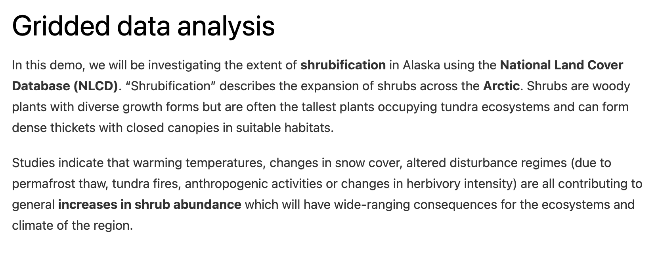
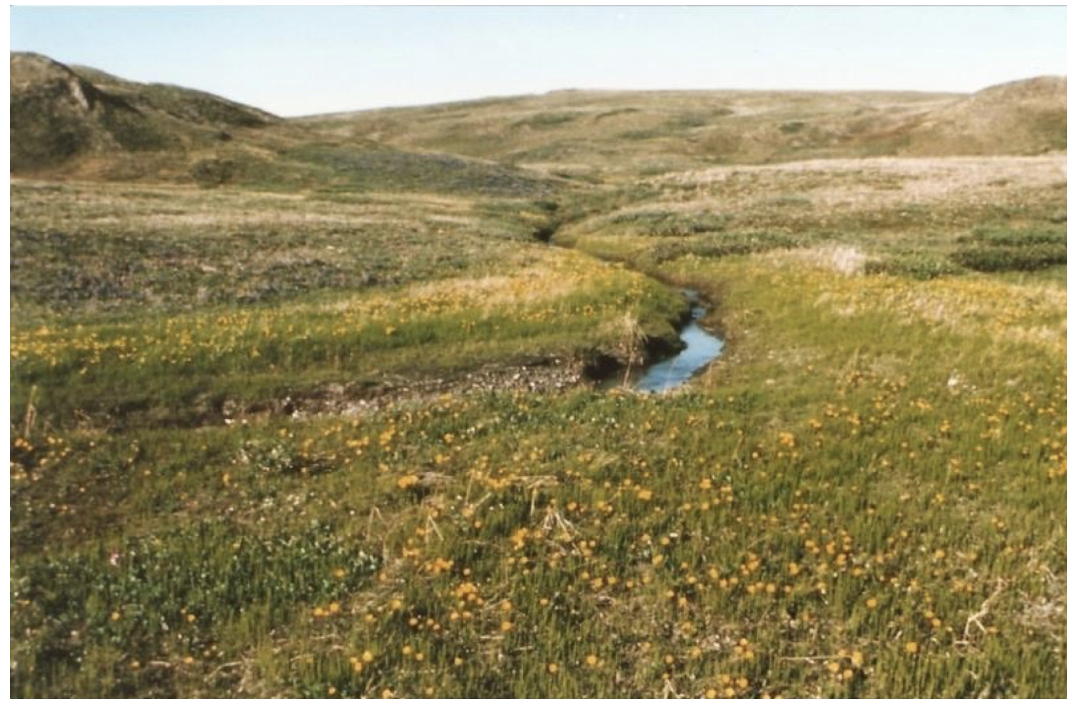
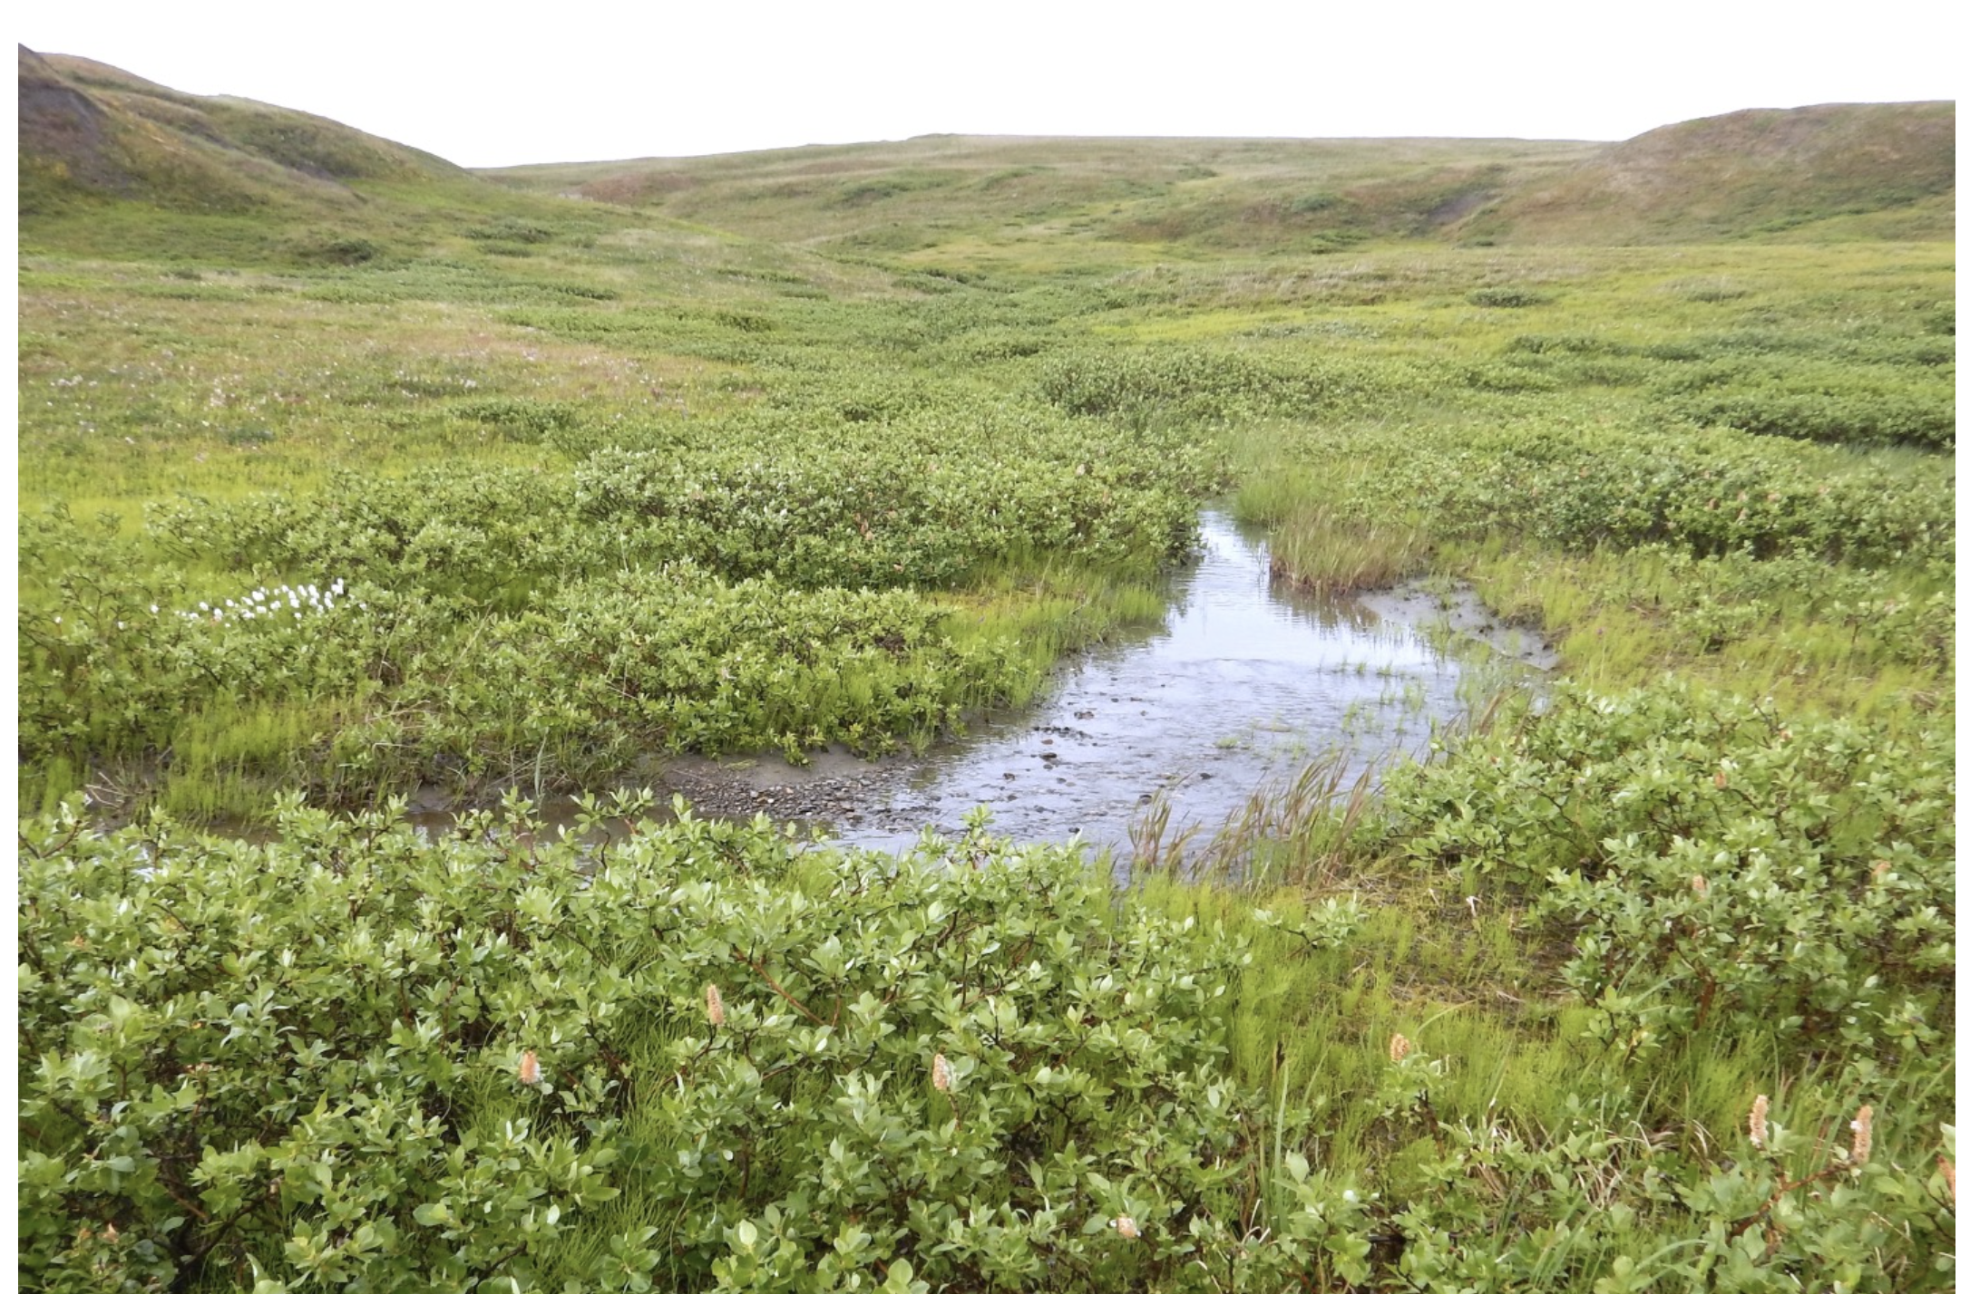

Slide 4
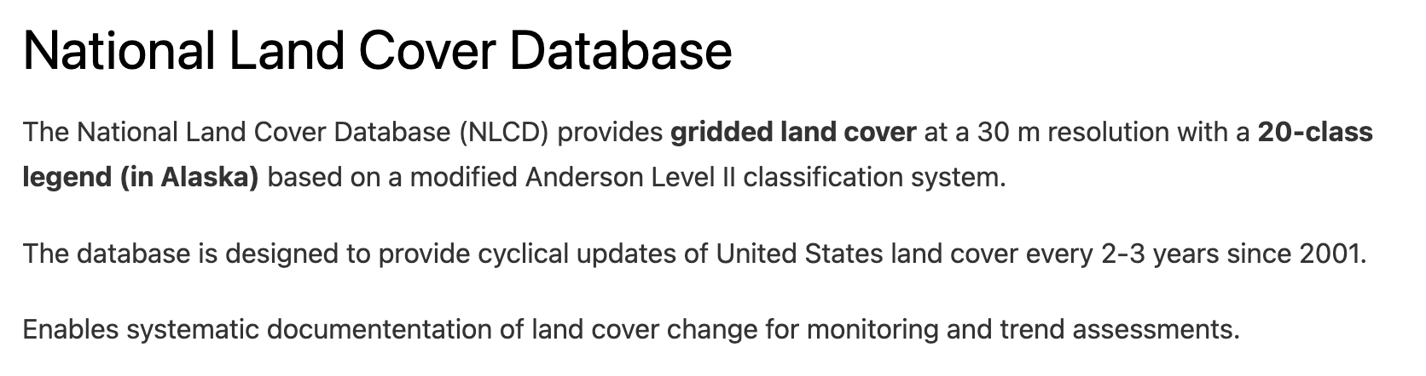
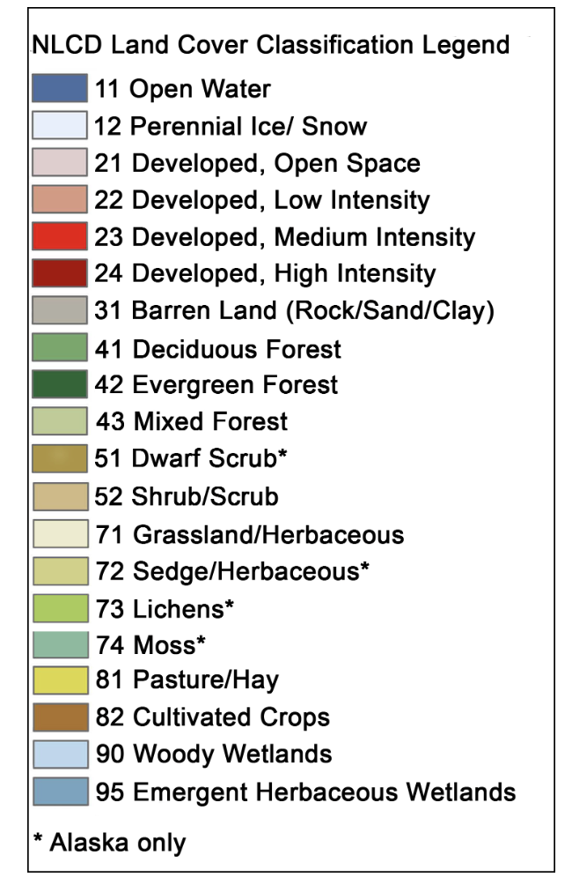
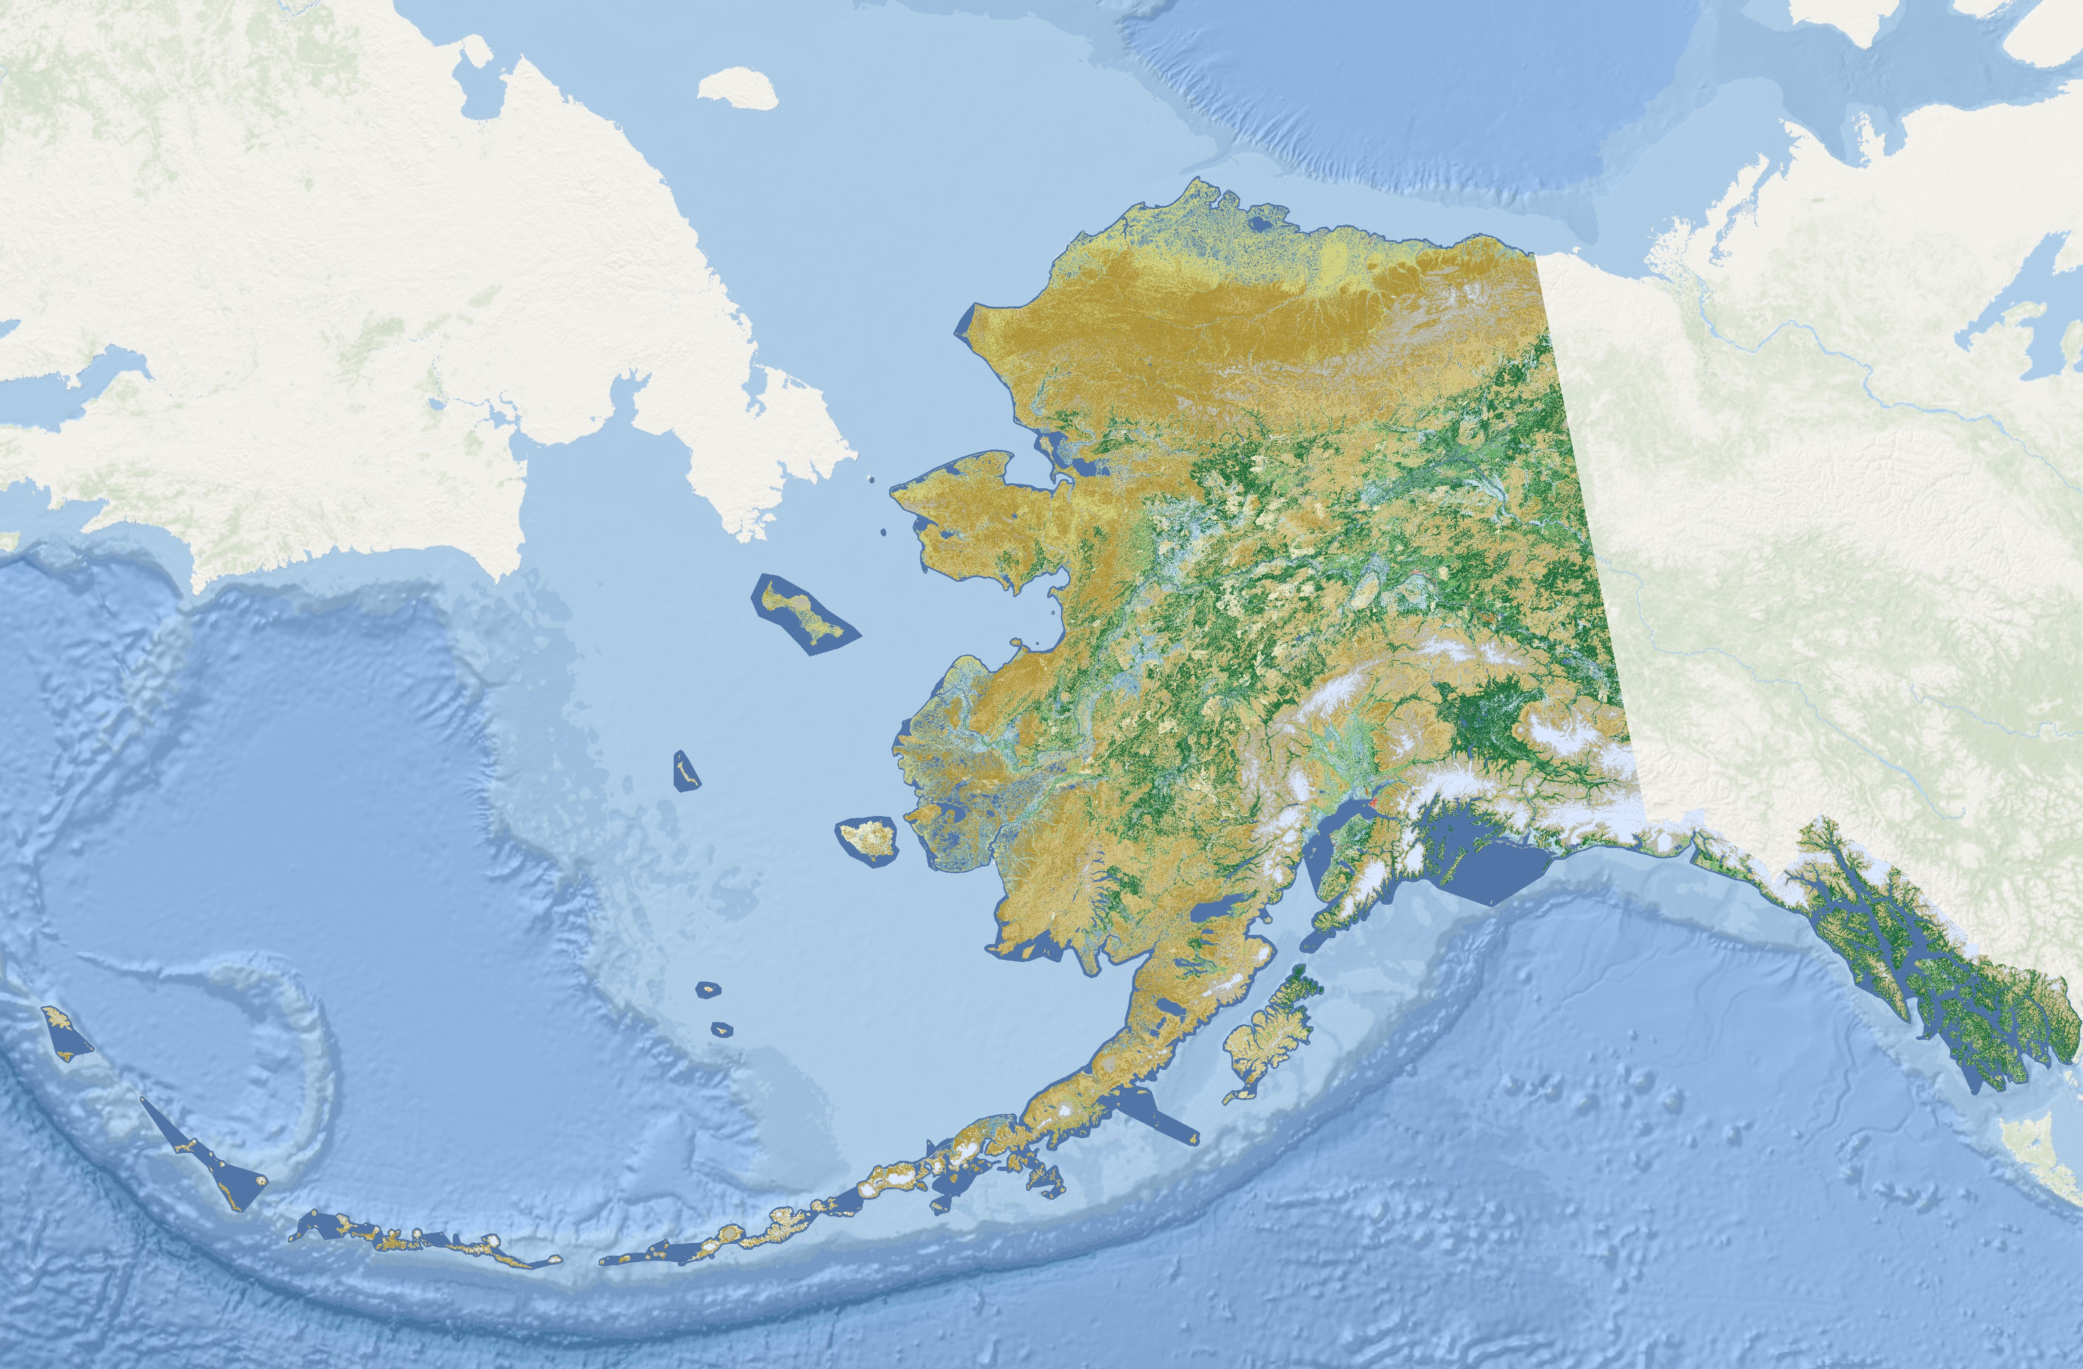

Slide 5
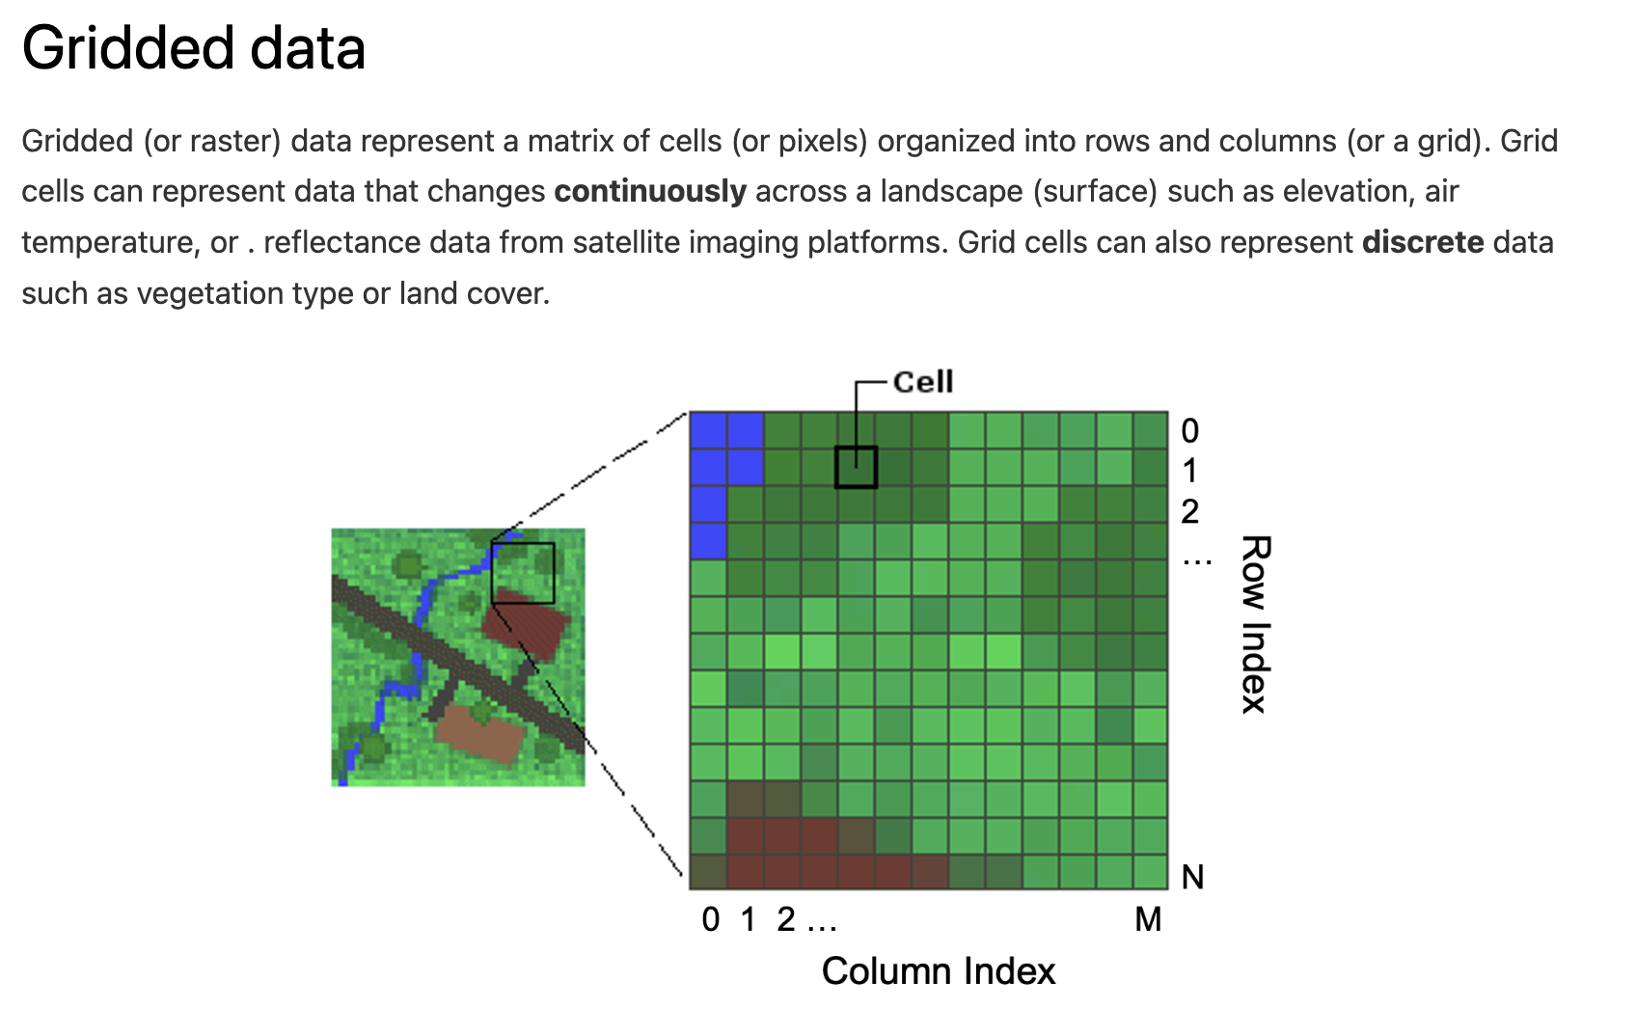

Slide 6
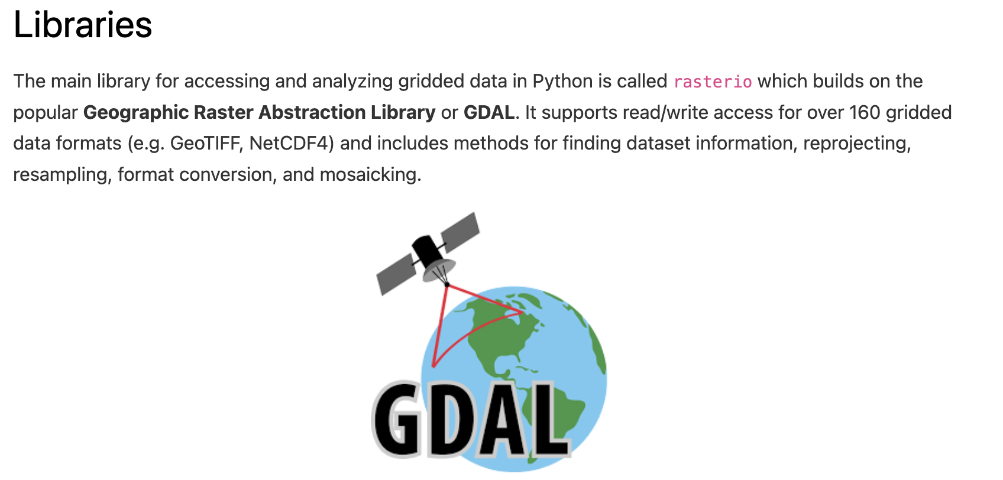

Slide 7
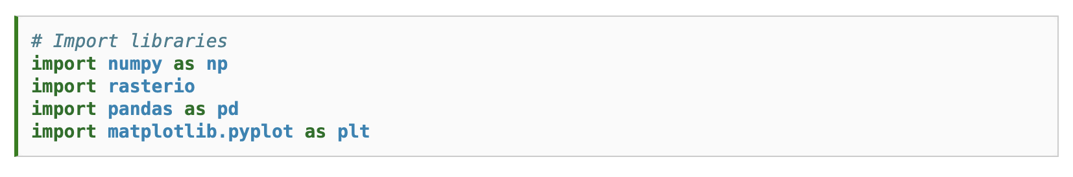

Slide 8
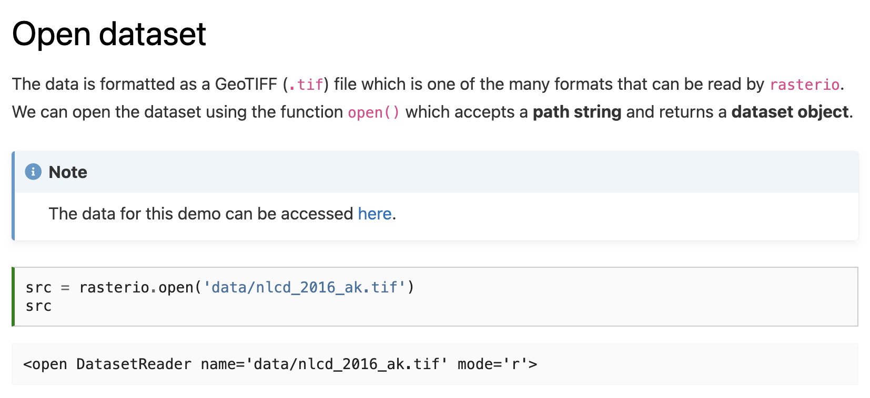

Slide 9
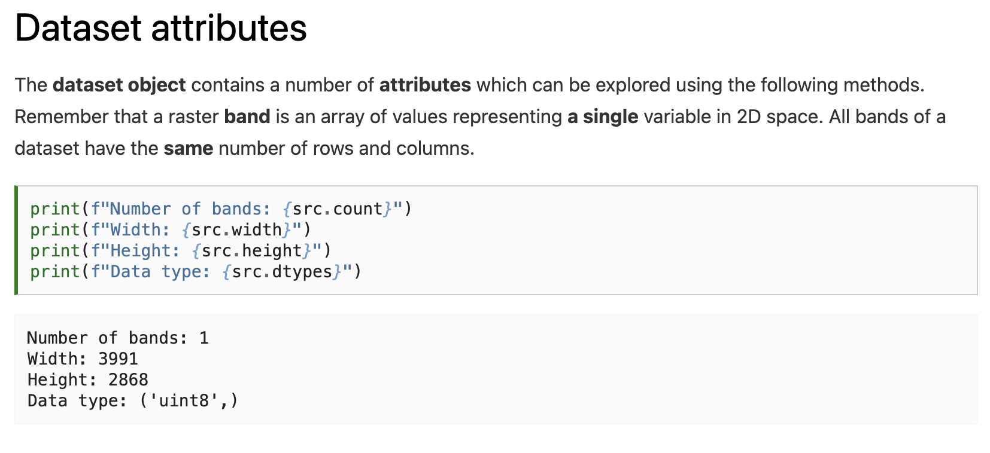
Notes:
How many different values can be stored in an uin8?

Slide 10
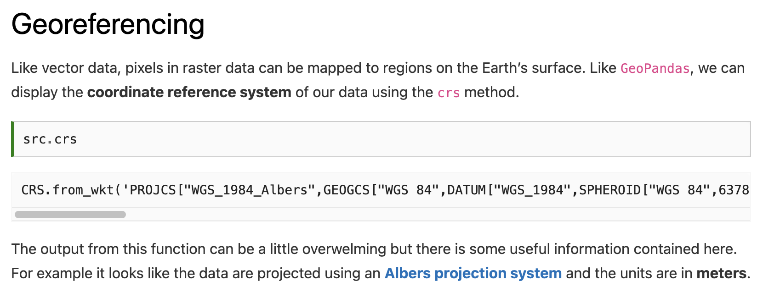

Slide 11
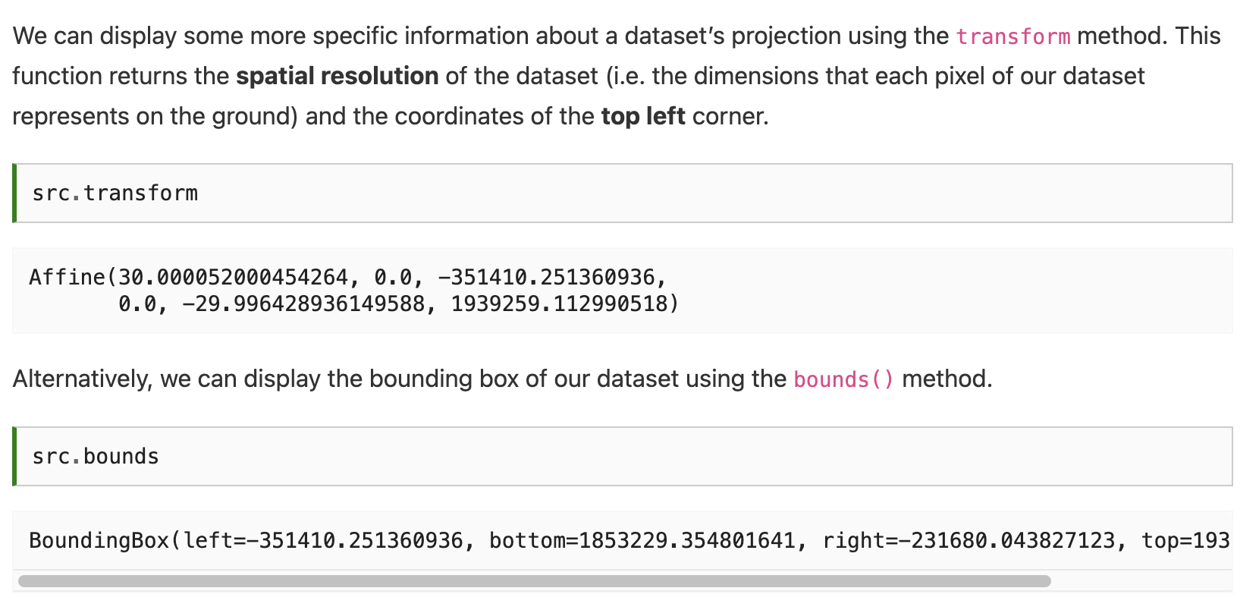

Slide 13
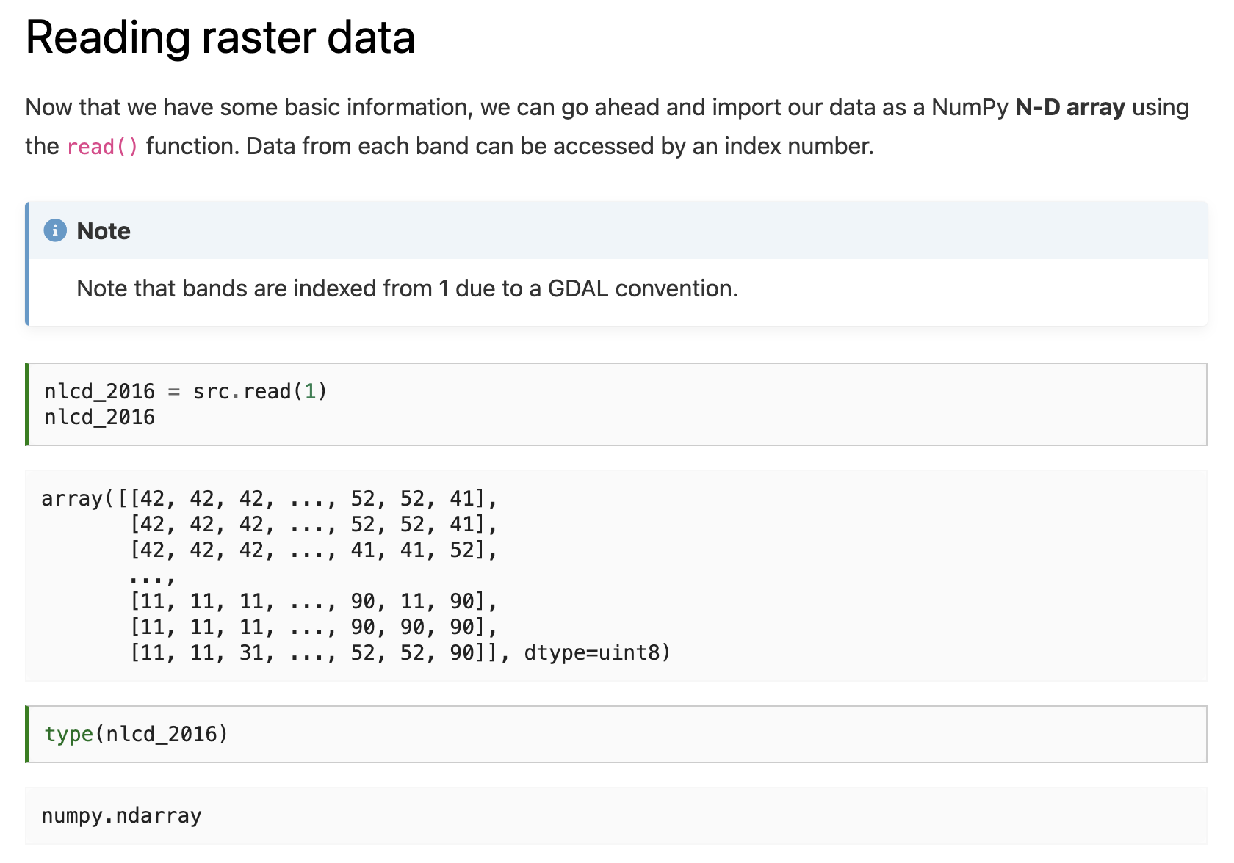

Slide 15
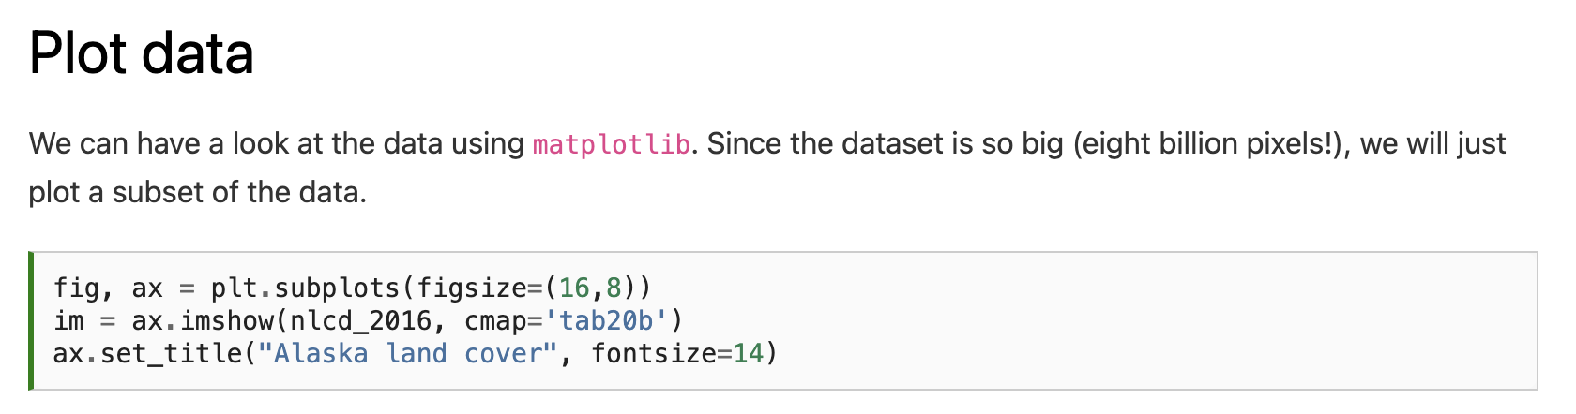
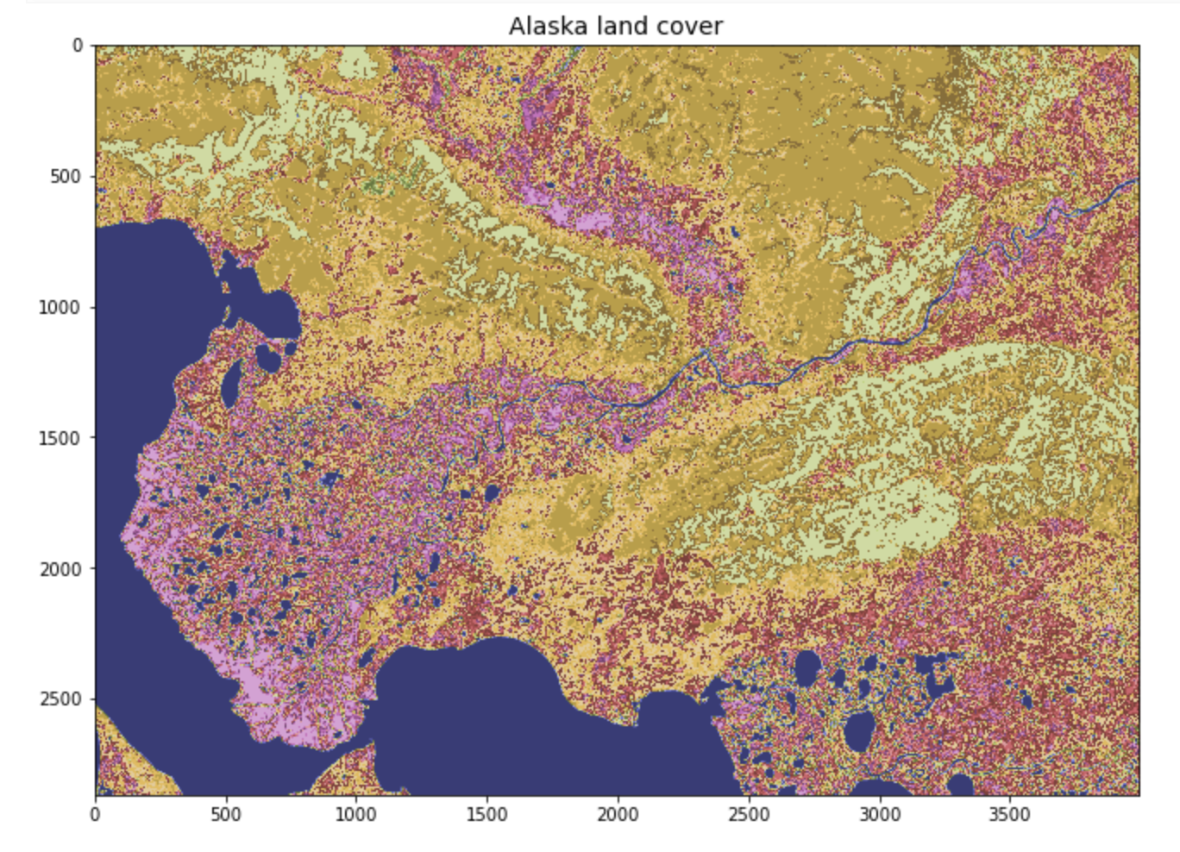

Slide 16
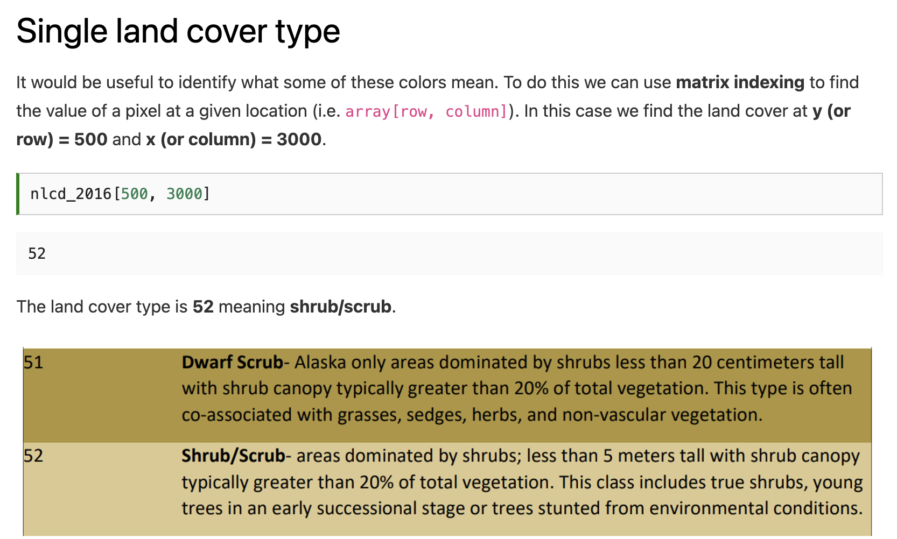

Slide 17
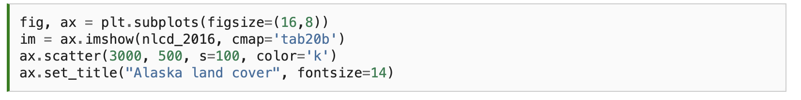
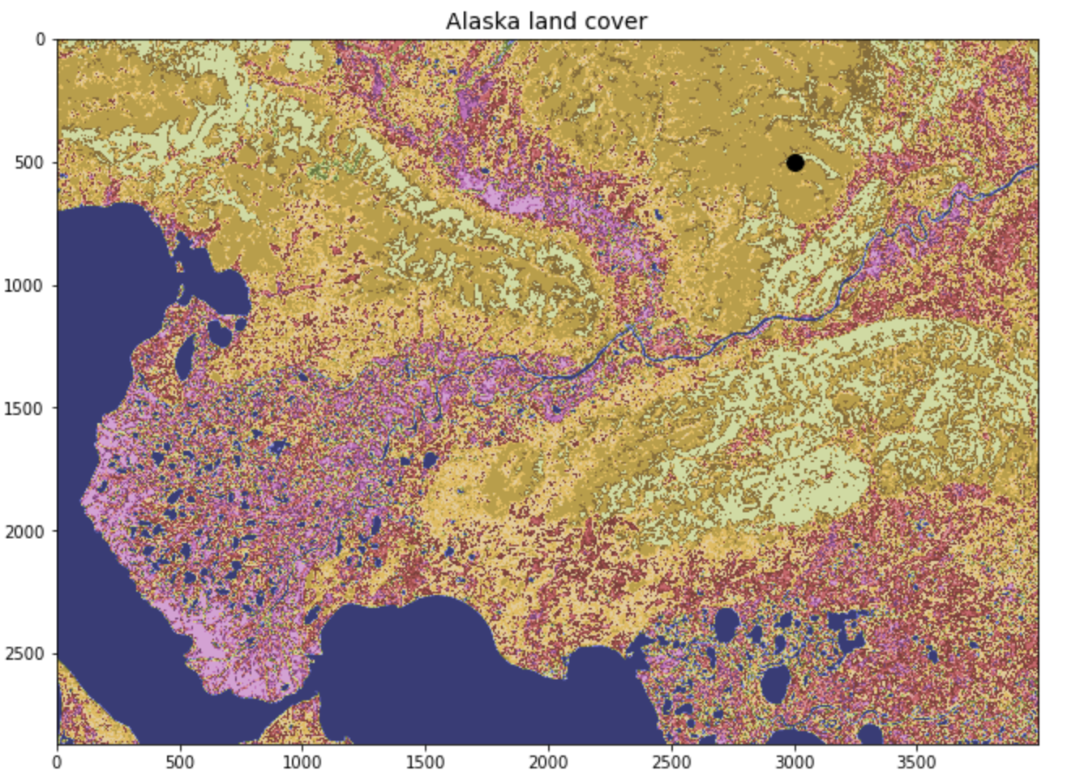

Slide 18
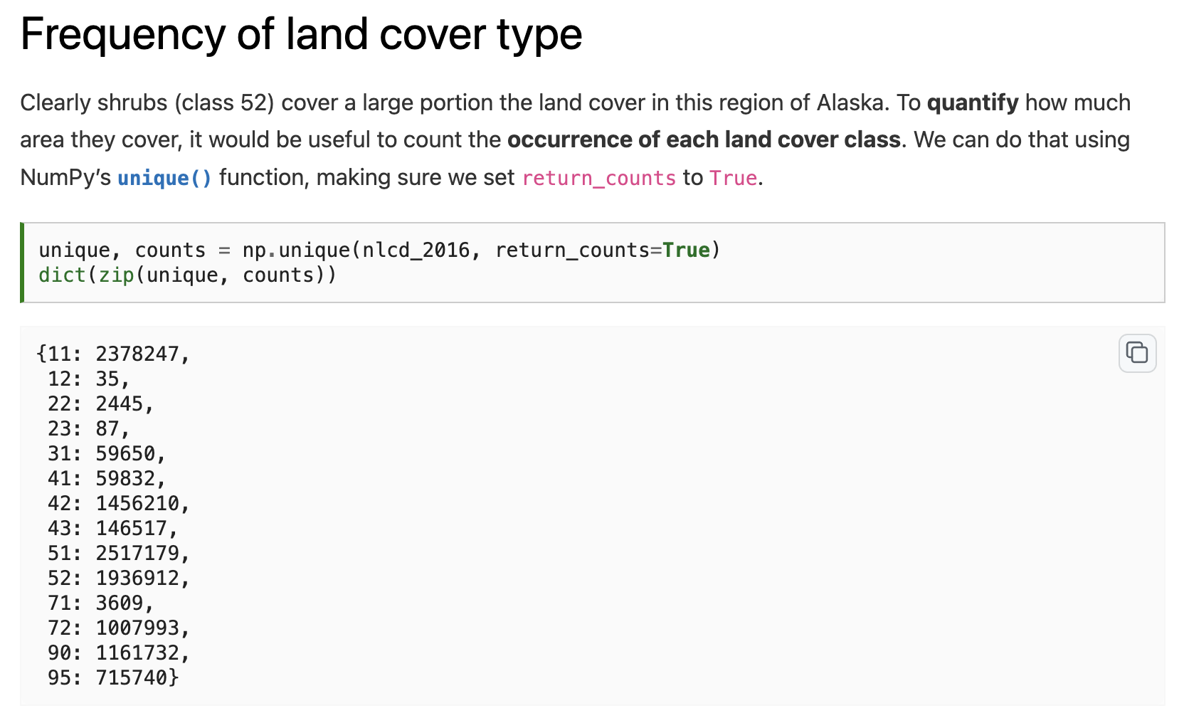

Slide 20
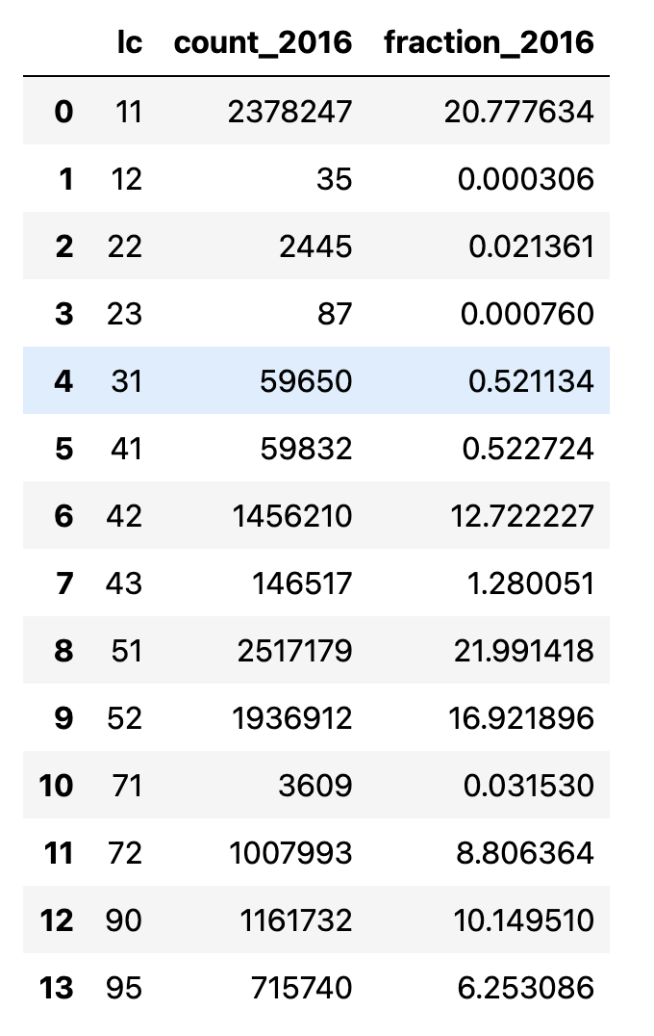
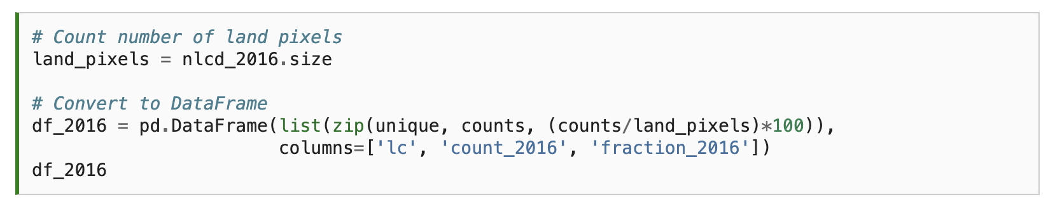

Slide 21
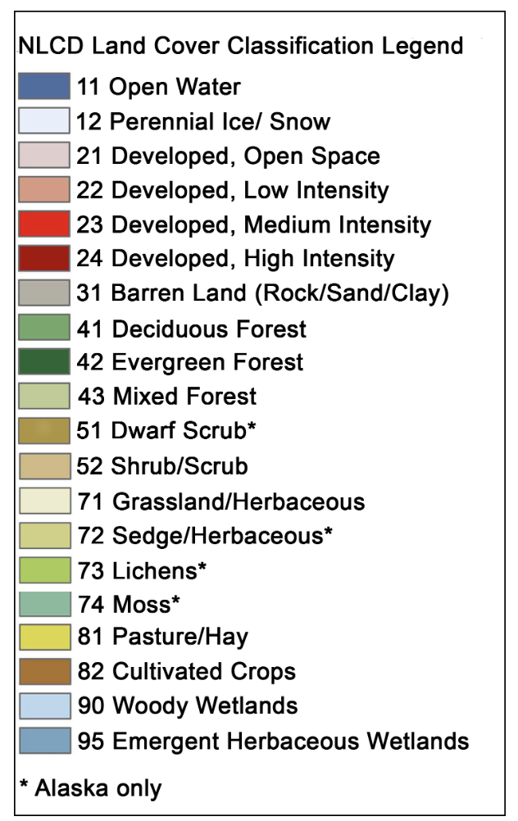

Slide 22
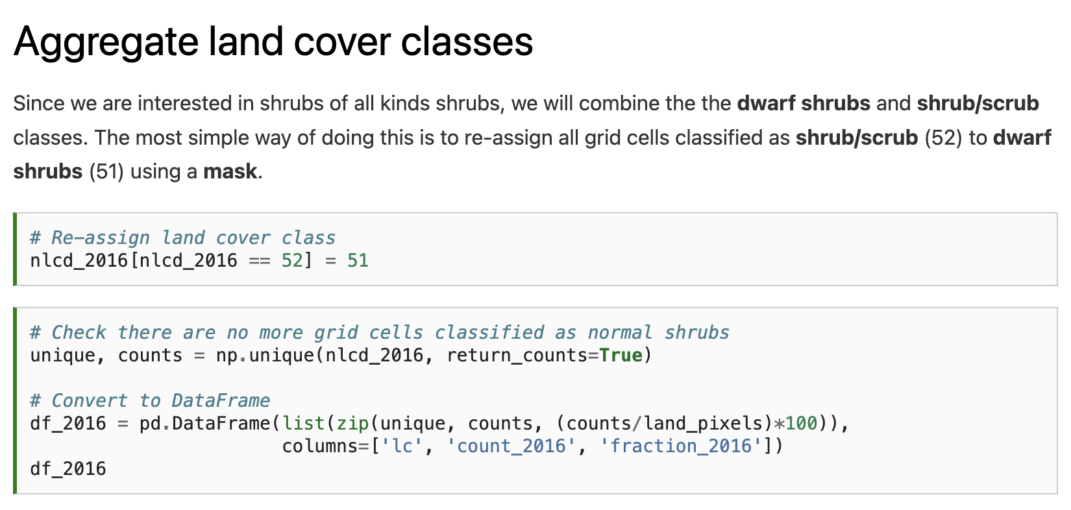

Slide 23
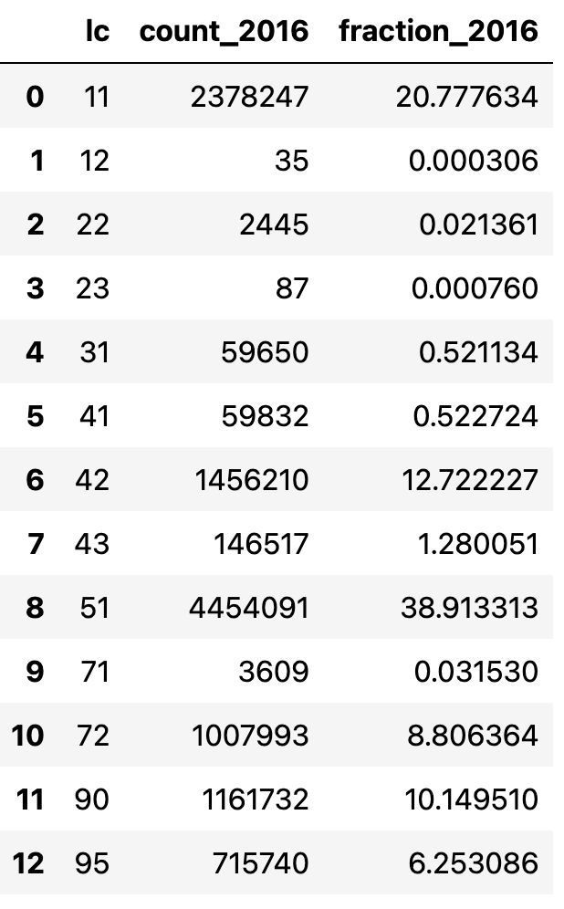

Slide 24
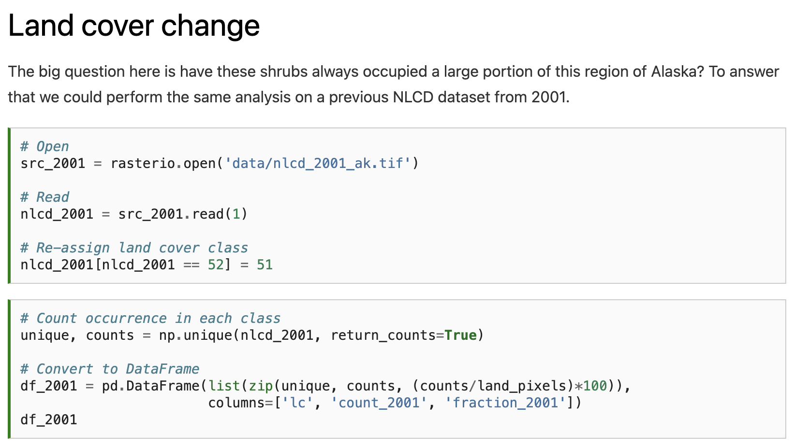
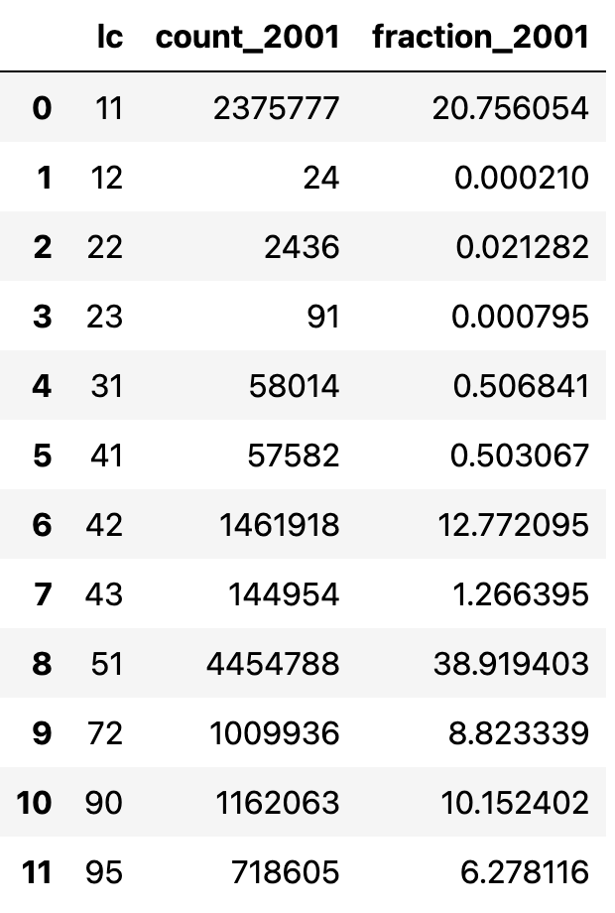

Slide 25
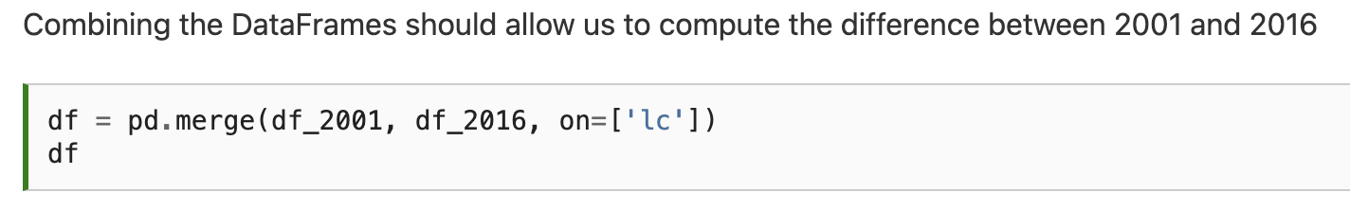
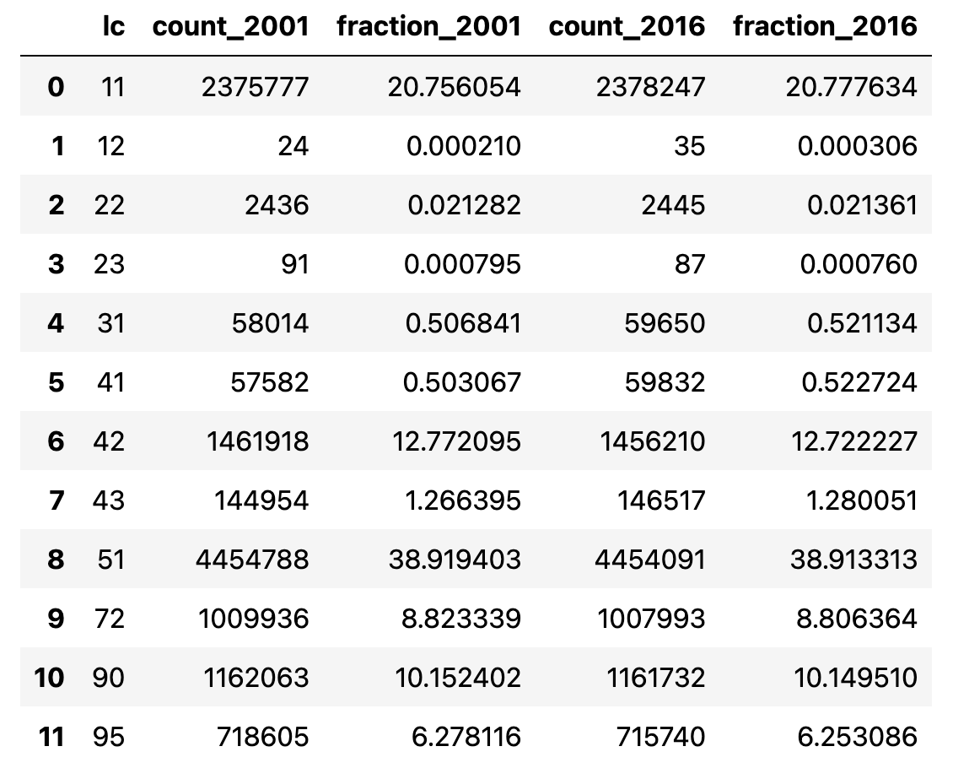

Slide 26
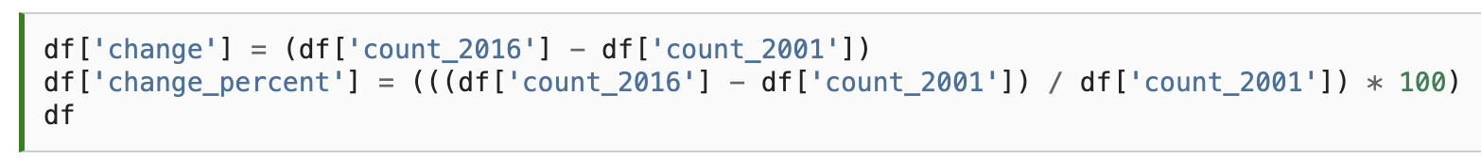
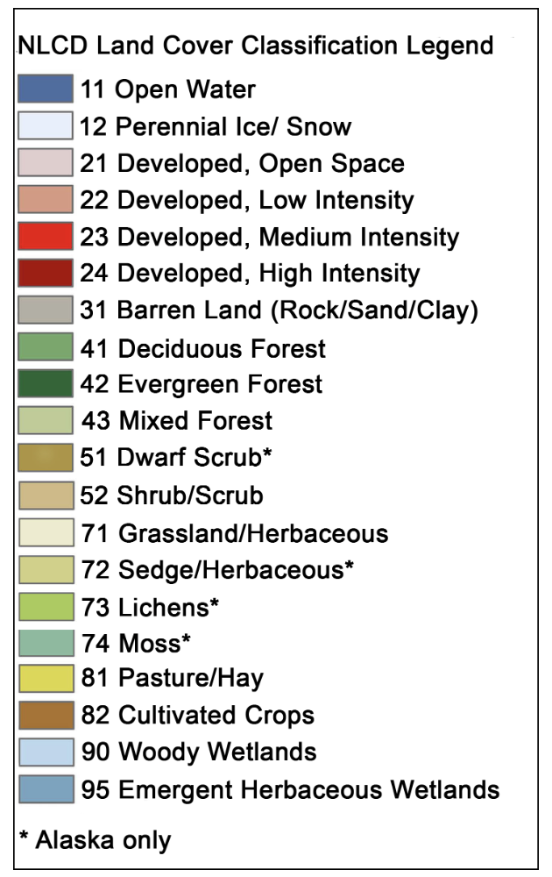
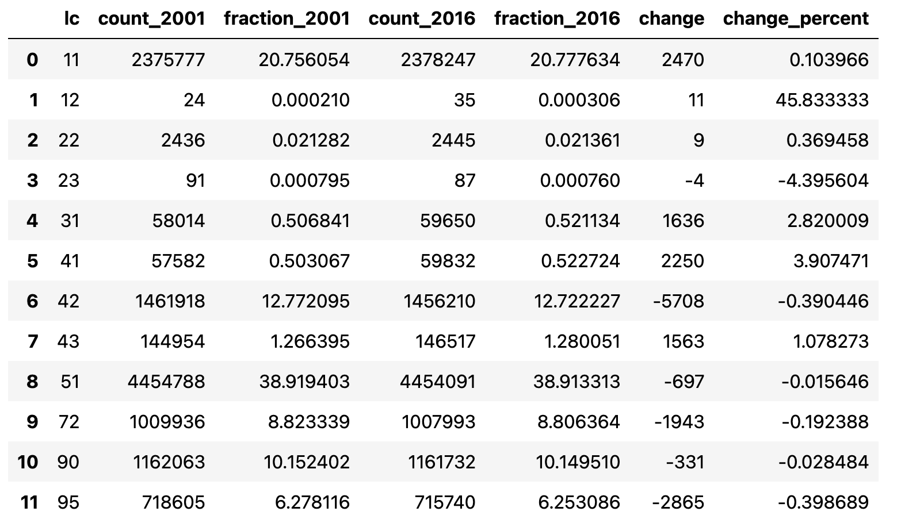
Notes:
Oh dear - the extent of shrubs did not increase between 2001 and 2016. One takeaway from this could be that shrubification is not happening in this region of the Arctic. But the percentage change in shrubs was very small (-0.02%) and could well be smaller than the uncertainty in our land cover product. For example, if just 1% of pixels were incorrectly classified as shrubs in 2001 our result would be insignificant. Other, perhaps more significant changes, that occurred between 2001 and 2016 include an increase in deciduous forest (41) by 3.9%, a decrease in evergreen forest (42) by 0.4%, and a decrease in emergent herbaceous wetlands (95) by 0.4%.

Slide 27
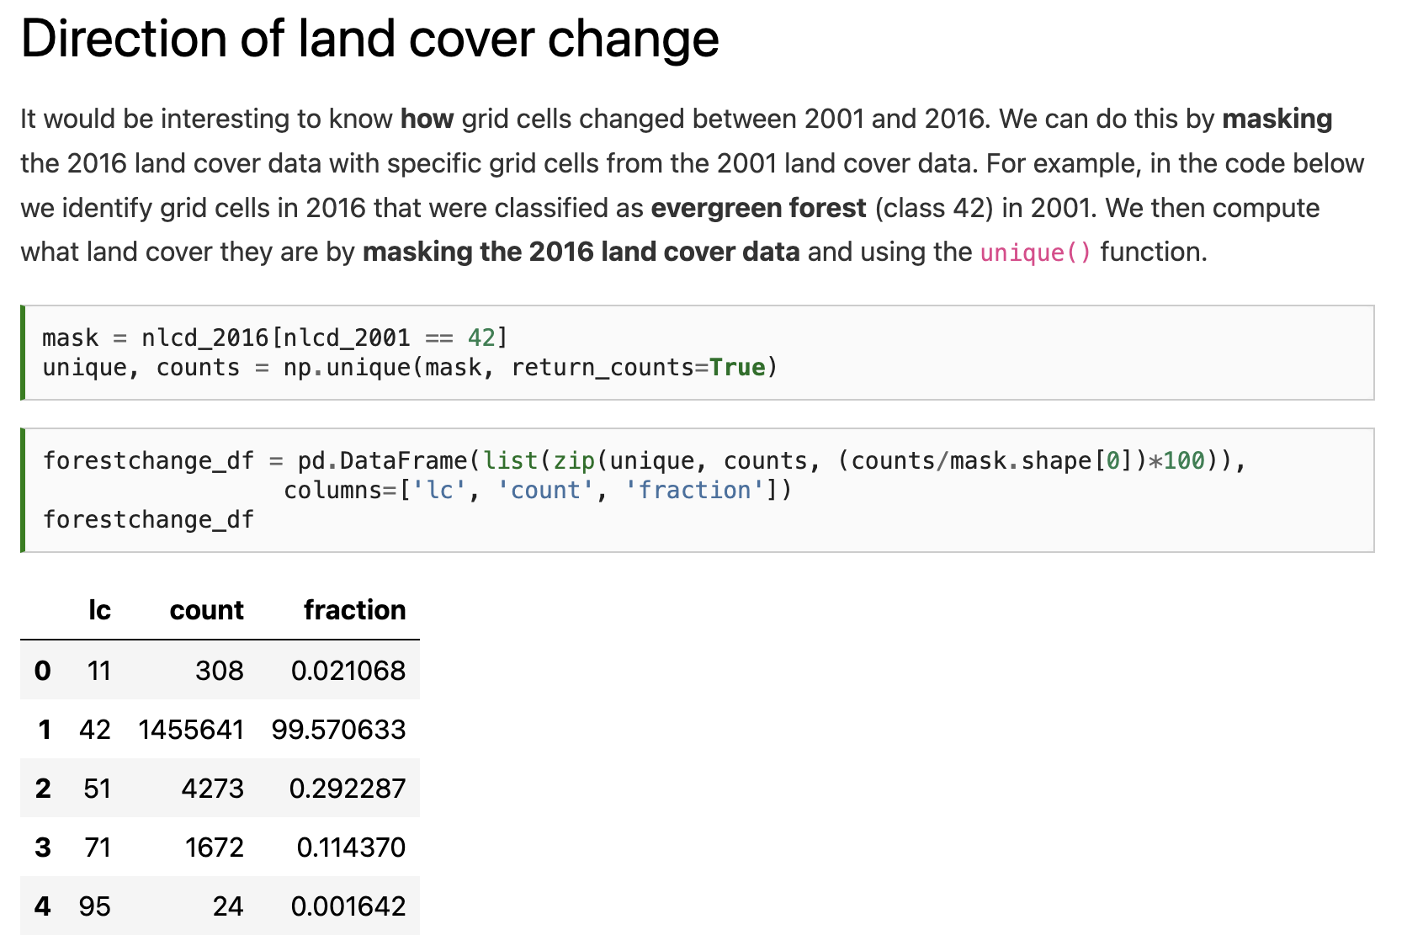

Slide 29
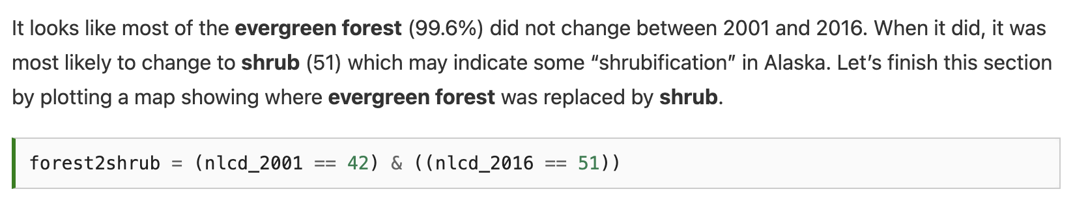

Slide 30
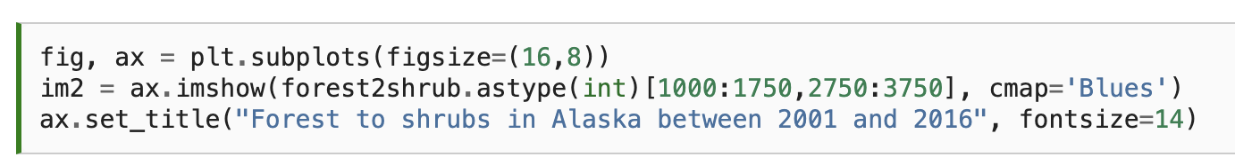
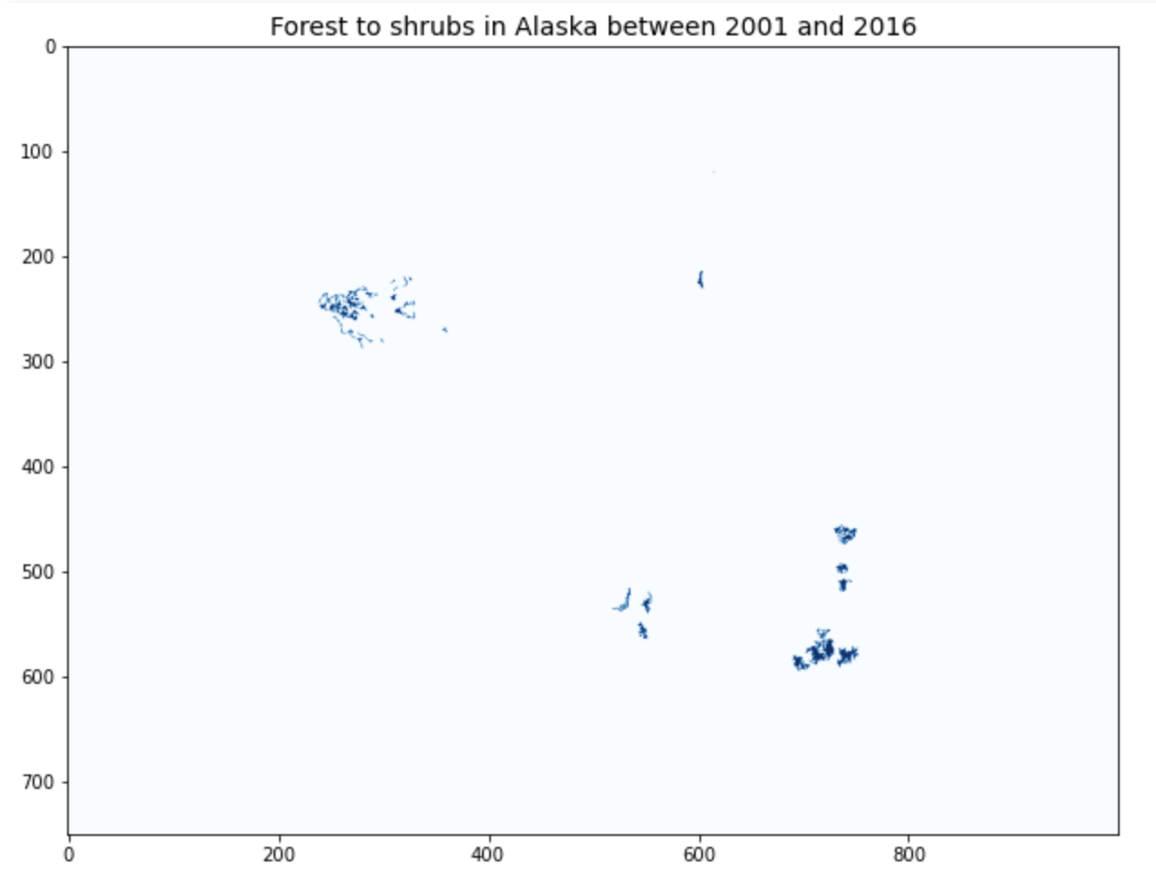

Slide 31
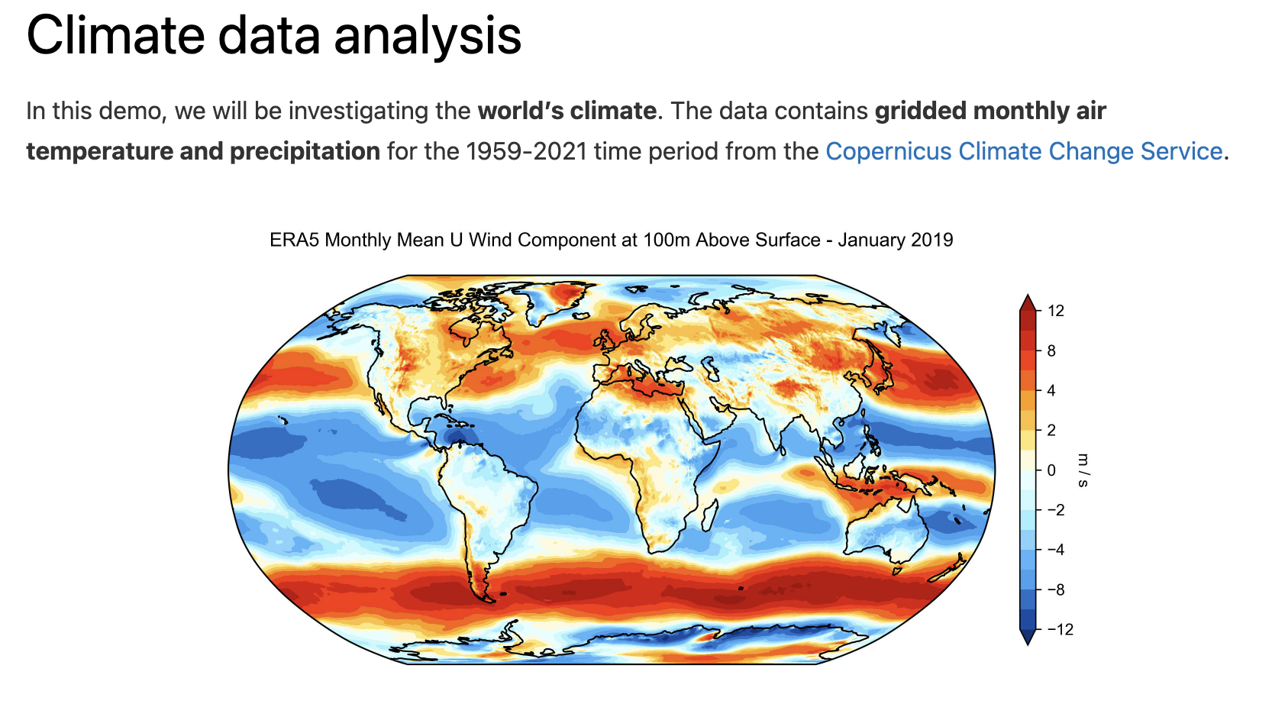

Slide 32
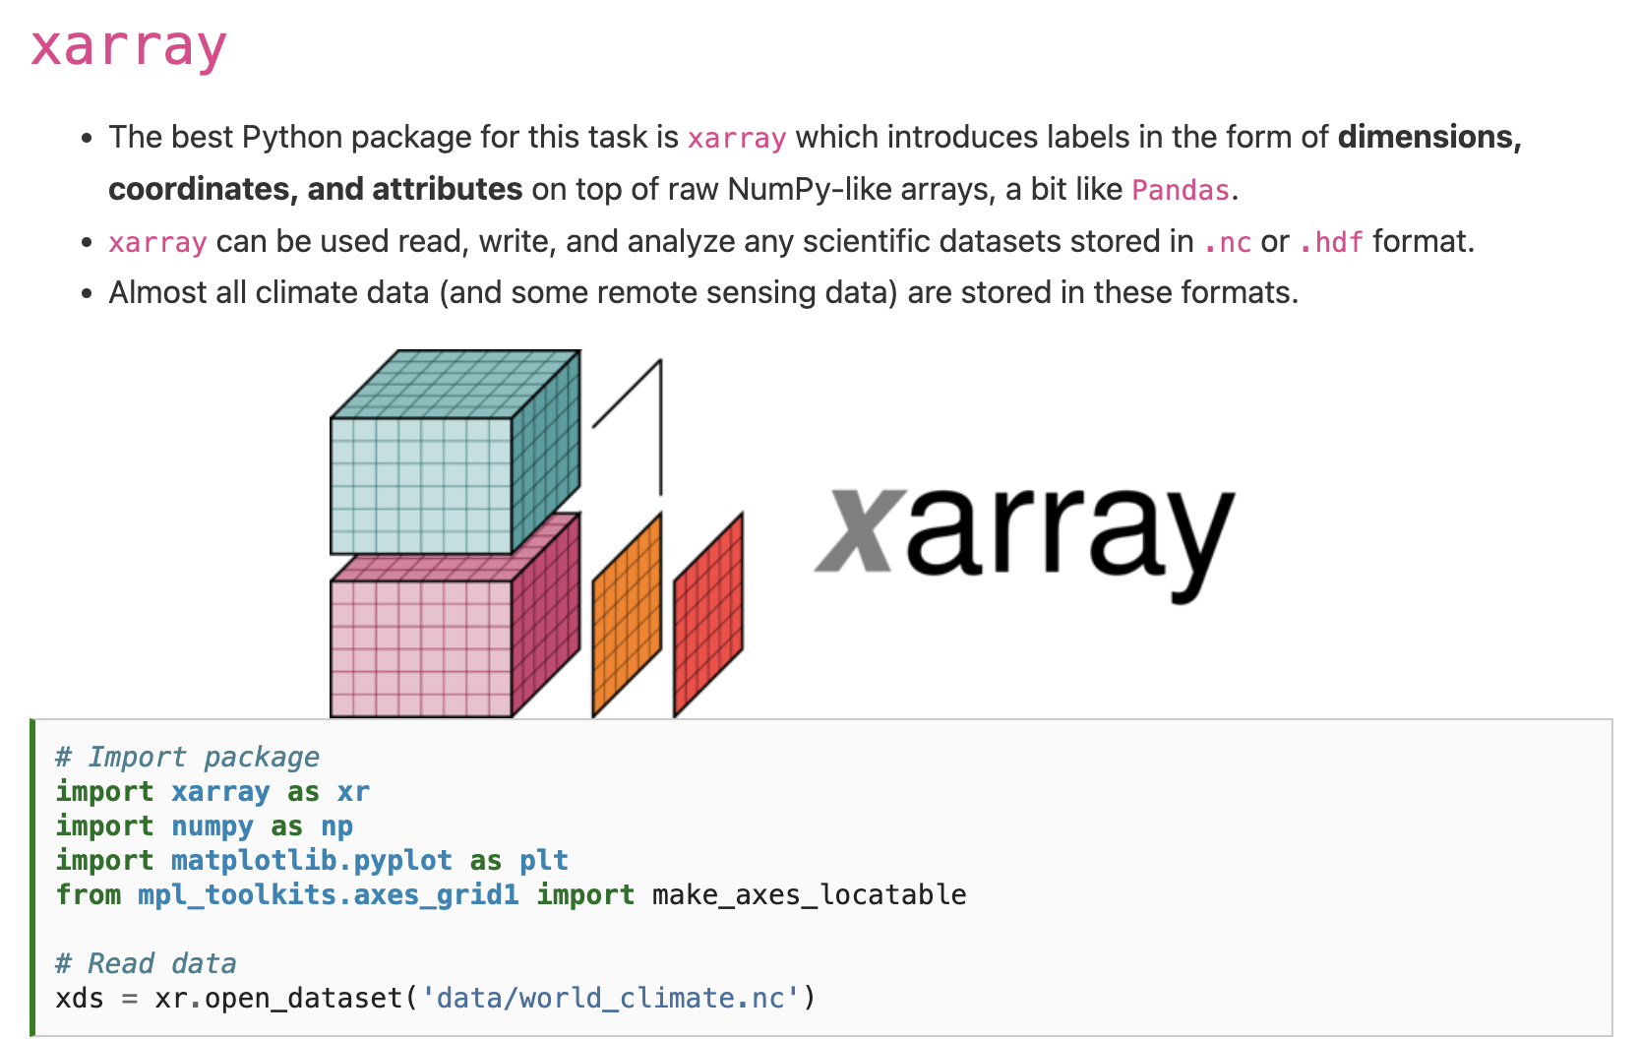

Slide 34
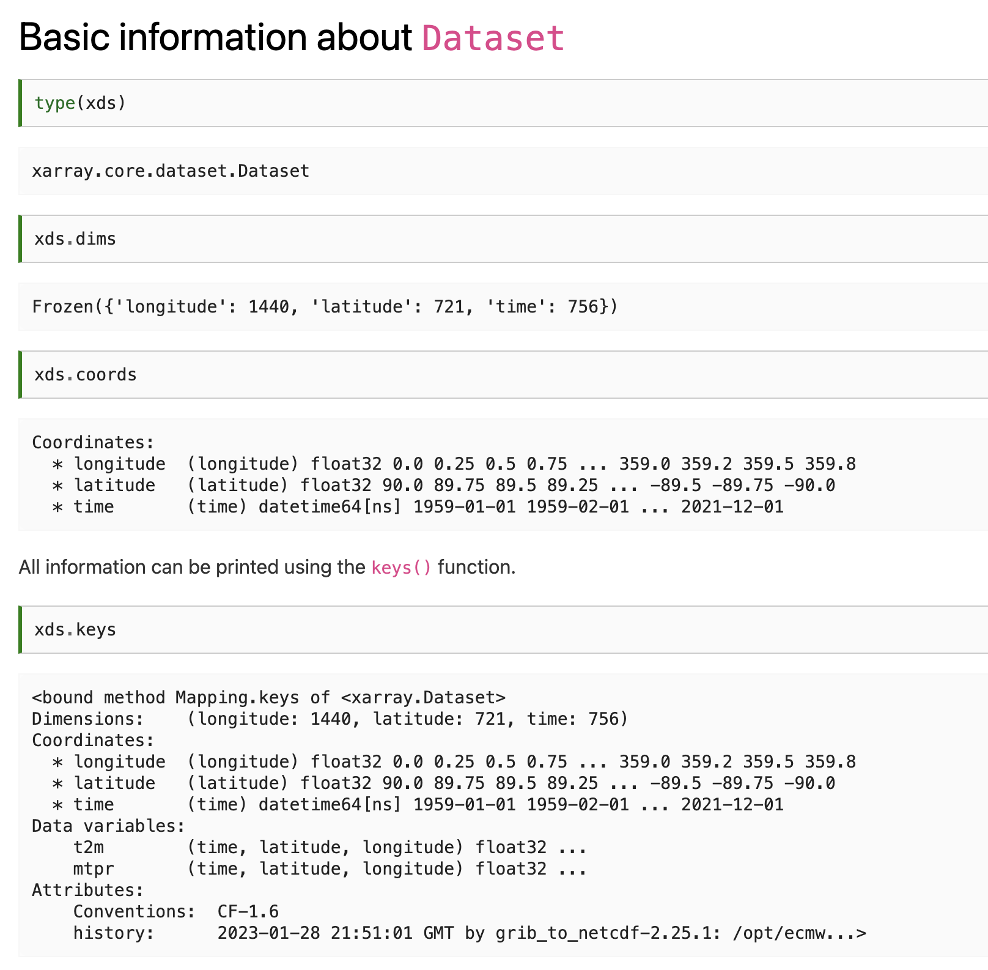

Slide 37
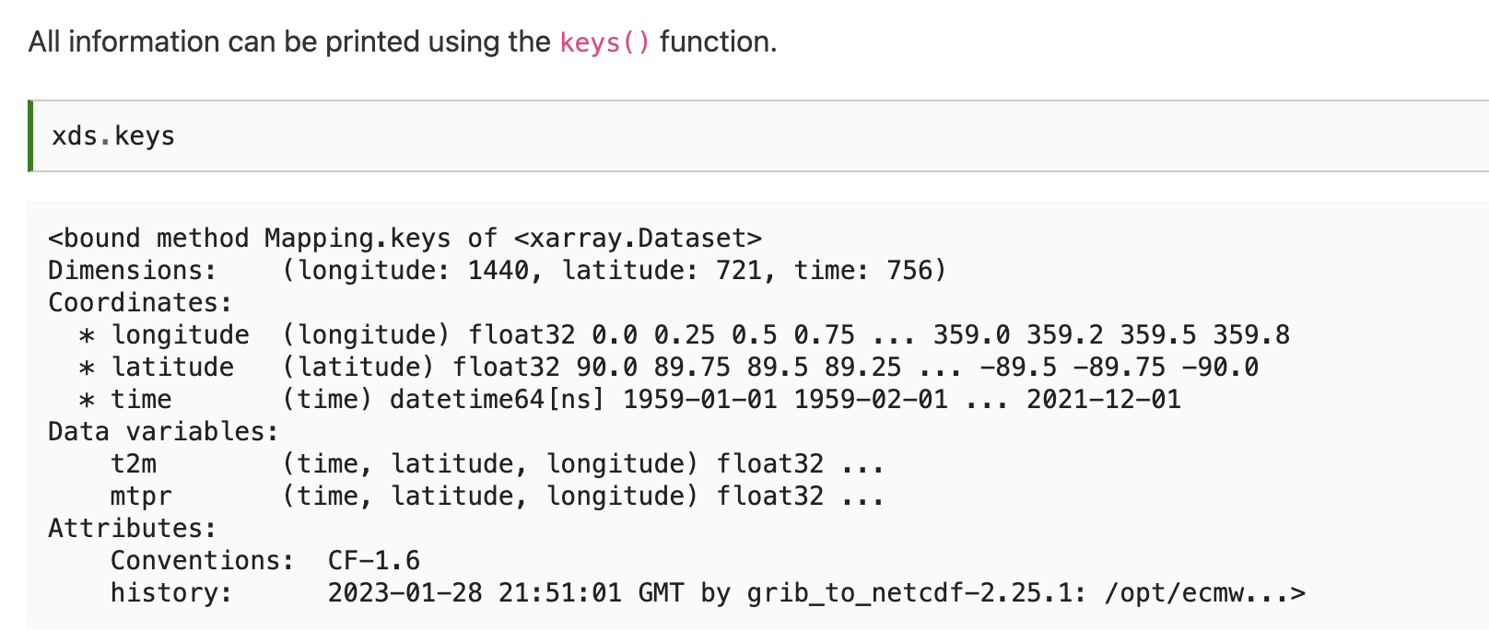
Notes:
t2m stands for 2 m above the surface, the standard height used by temperature sensors. It is a common metric used in climatology but note that it is different from the surface temperature which would be the temperature of the ground surface.

Slide 38
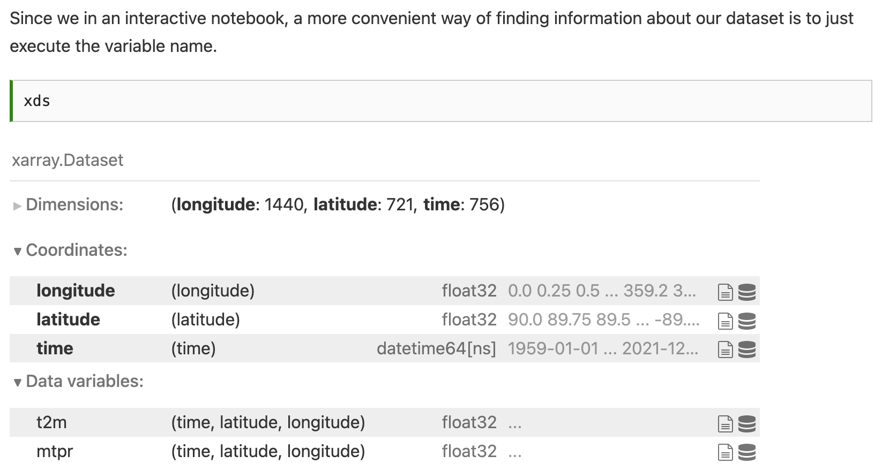
Notes:
\

Slide 39
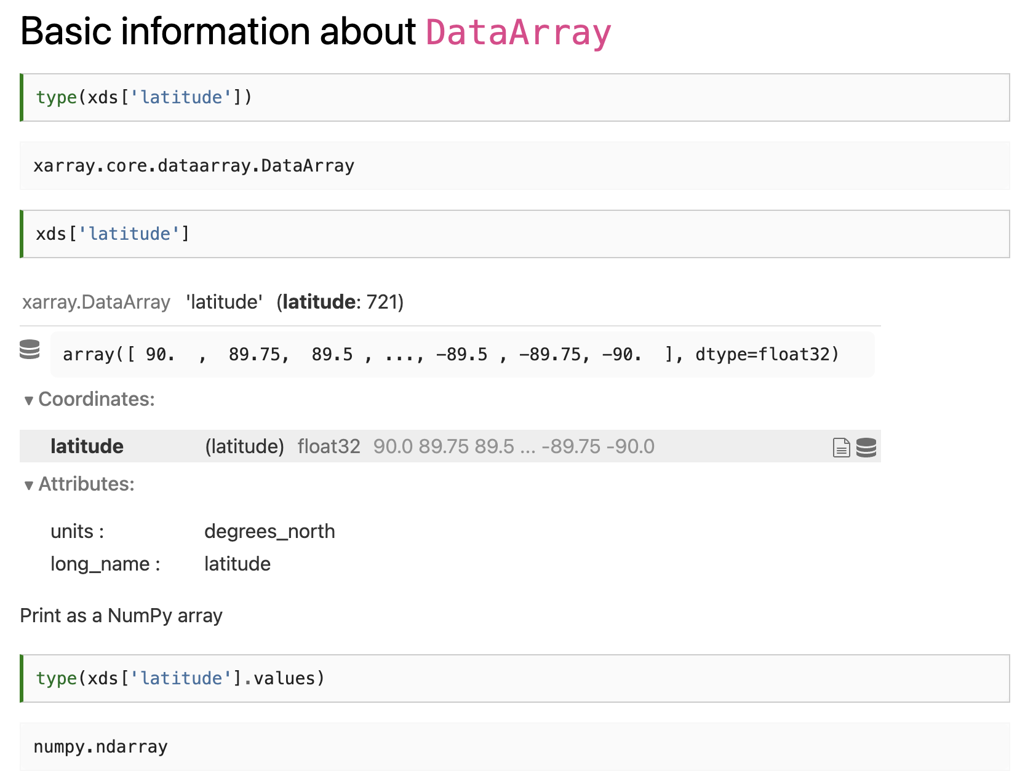
Notes:
\

Slide 40
Notes:
\

Slide 41
Notes:
\

Slide 42
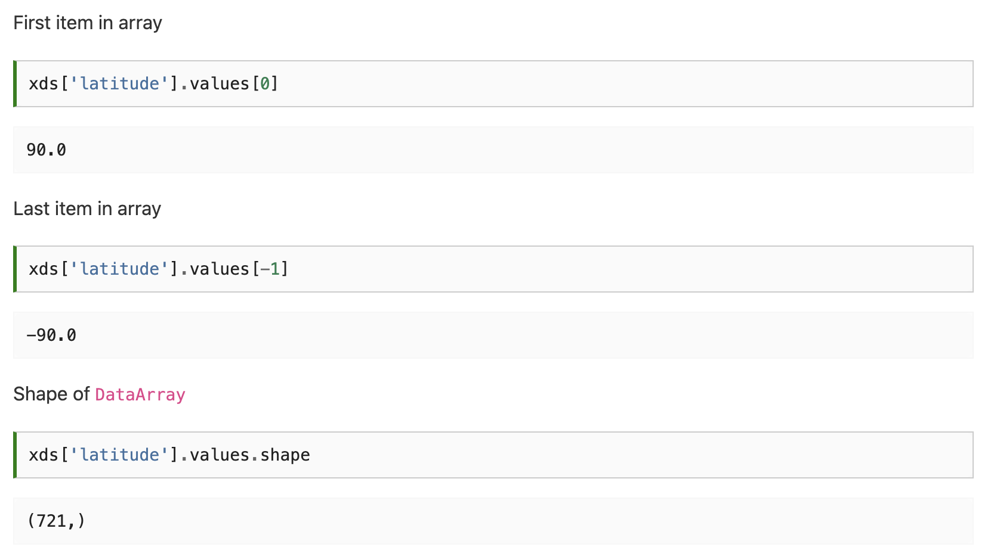
Notes:
\

Slide 43
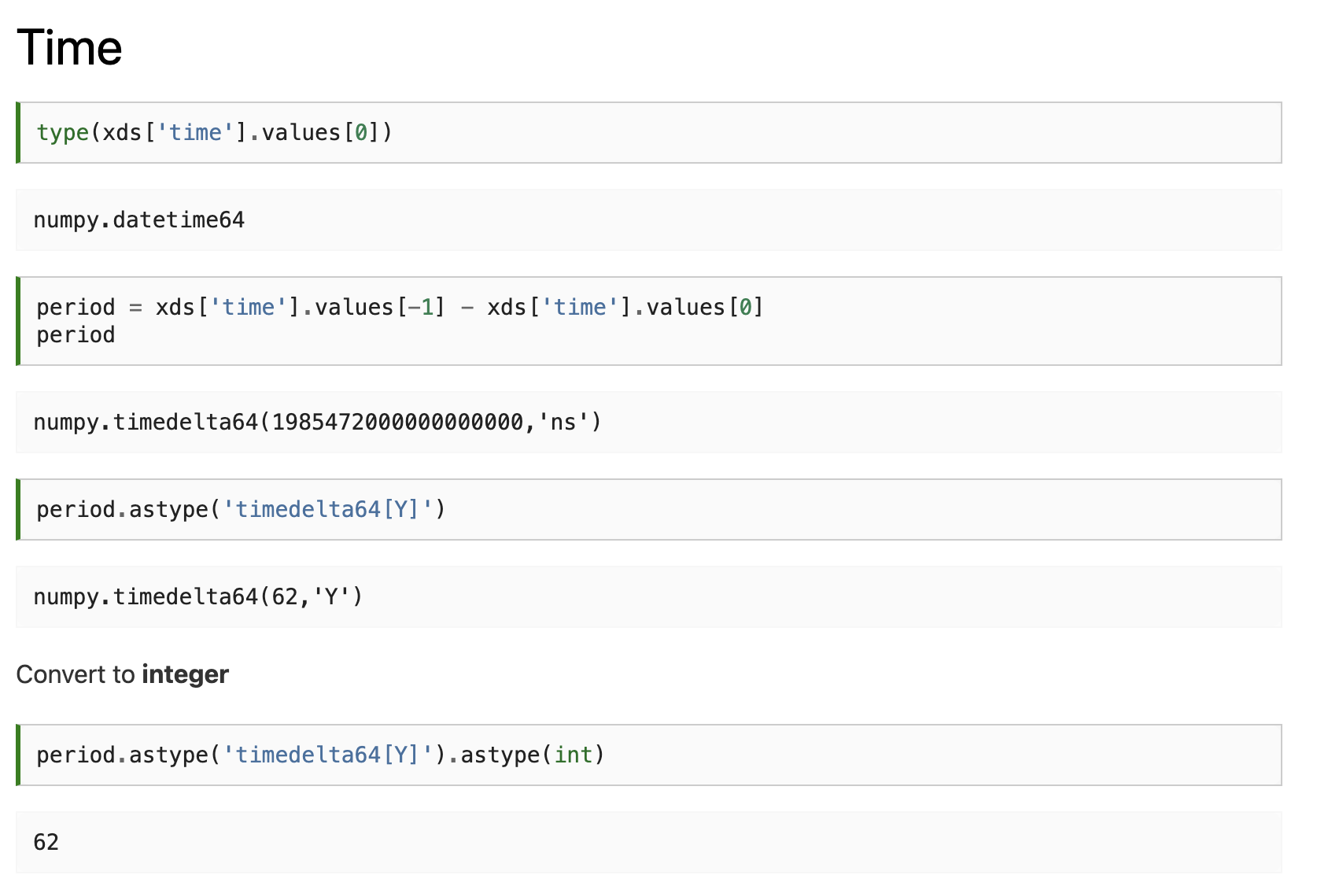
Notes:
\

Slide 44
Notes:
\

Slide 45
Notes:
\

Slide 46
Notes:
\

Slide 47
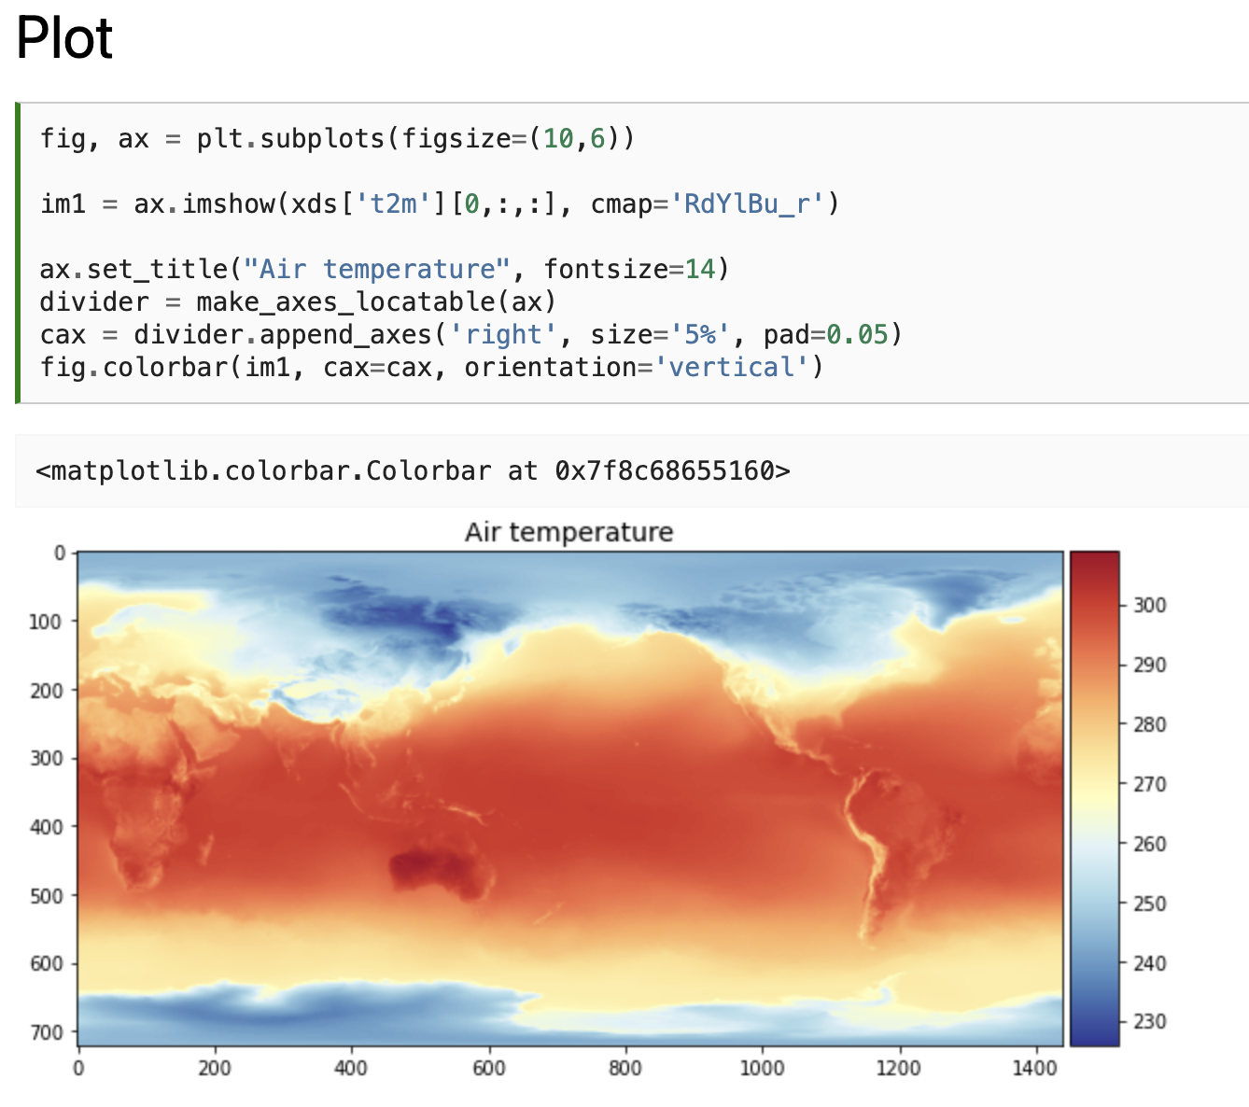
Notes:
\

Slide 48
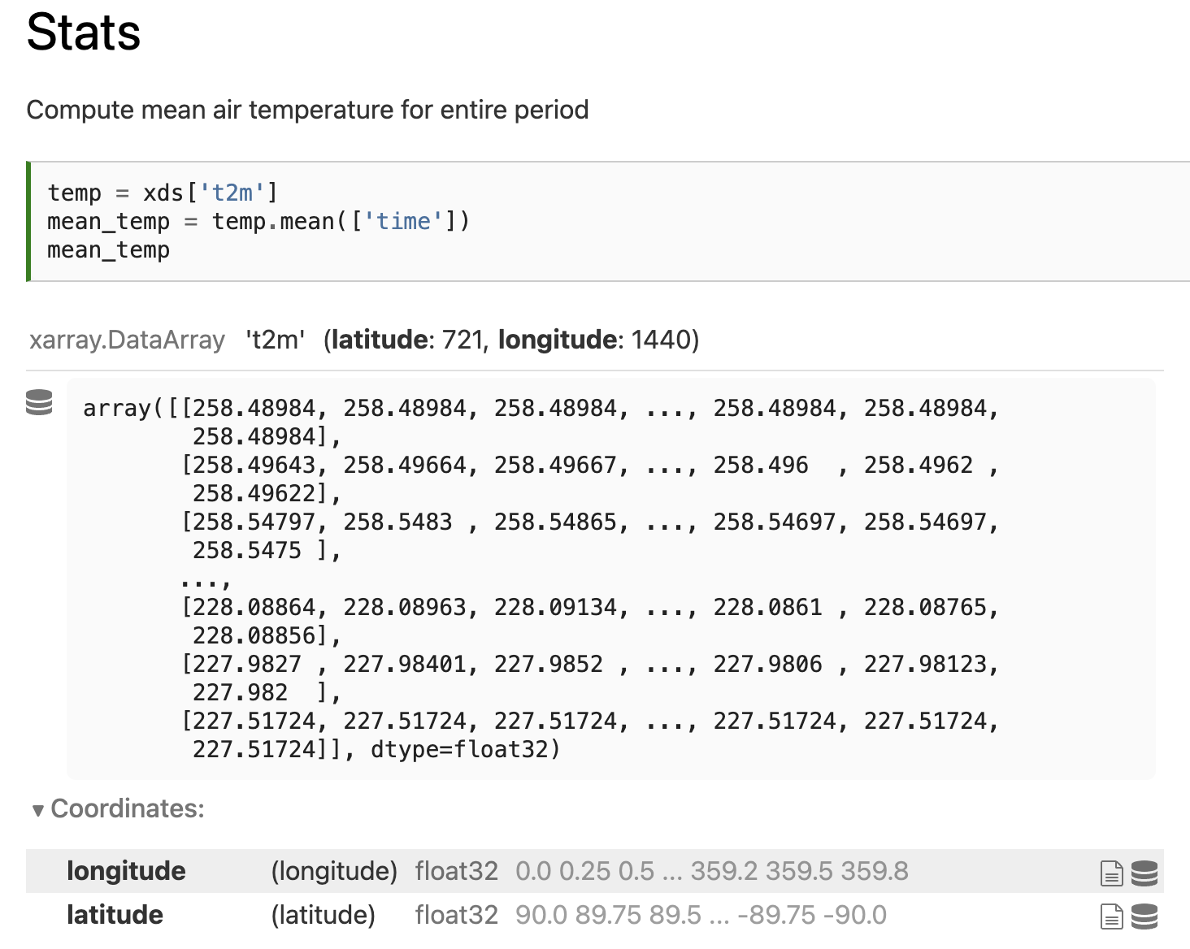
Notes:
\

Slide 49
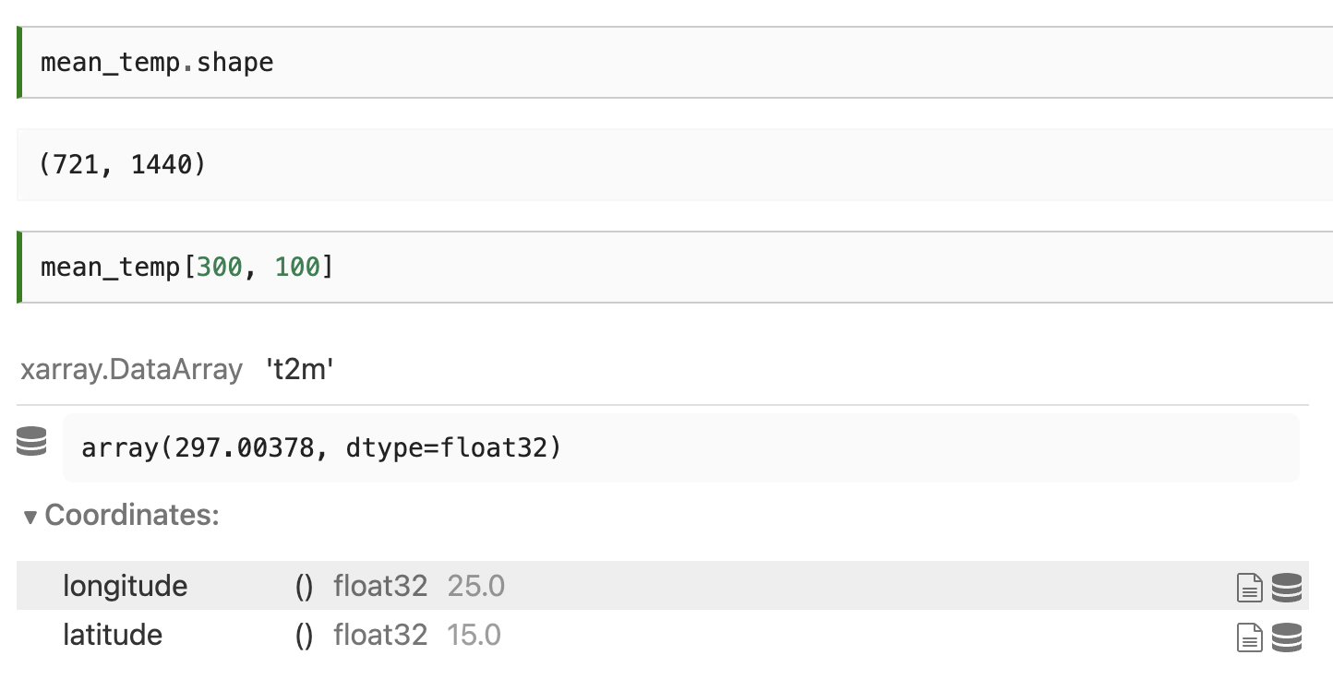
Notes:
\

Slide 50
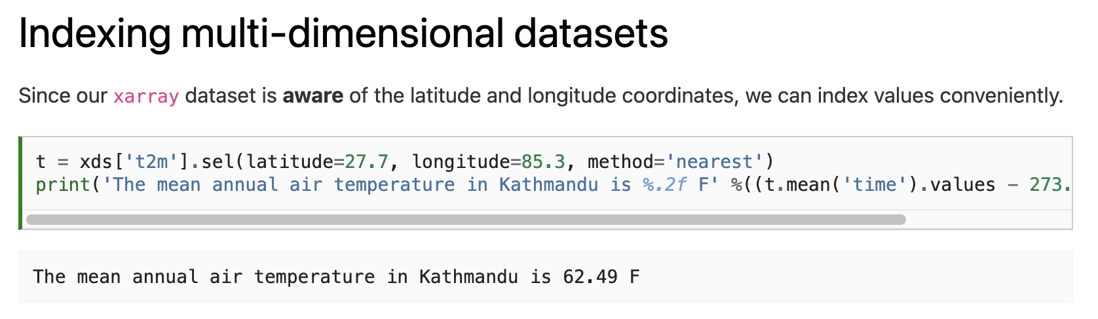
Notes:
\

Slide 51
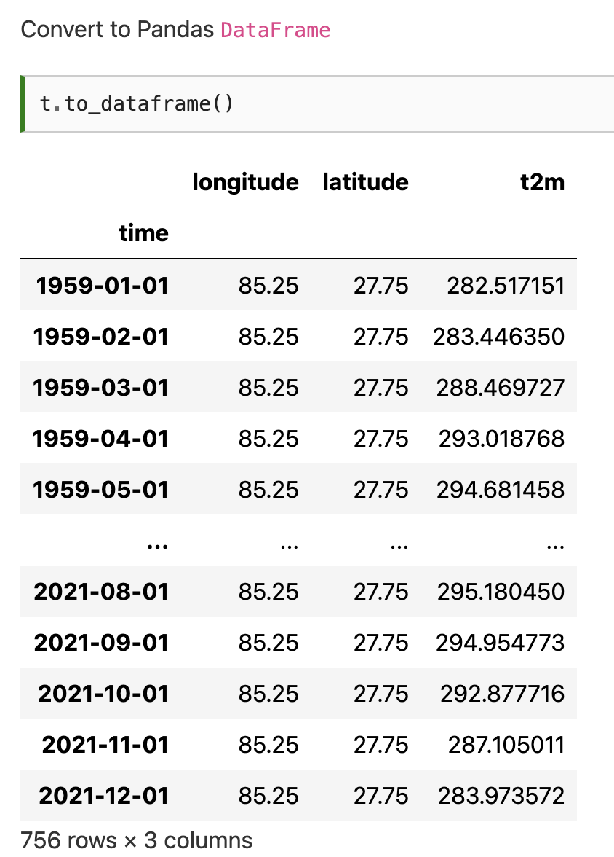
Notes:
\

Slide 52
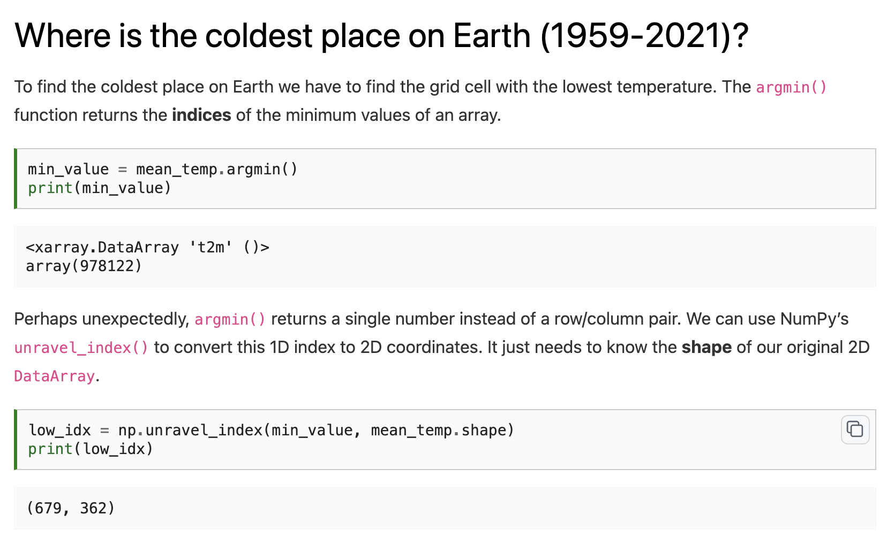
Notes:
\

Slide 53
Notes:
\

Slide 54
Notes:
\

Slide 55


Notes:
\

Slide 56

Notes:
\

Slide 57
Notes:
\

Slide 58

Notes:
\

Slide 59
Notes:
\

Slide 60

Notes:
\

Slide 61
Notes:
\

Slide 62


Slide 63
Next time: Machine learning
Email: jryan4@uoregon.edu
Office: 163A Condon Hall
Office hours: Monday 15:00-16:00 and Tuesday 14:00-15:00

